Slide 1
Training Across the
A Survey & Its Results
Marta Ambroziak, Jay Kibby and Christine Sisak

Slide 2
Agenda
The survey
What we asked
Where responses came from
Response summary
Types of training
Types of cross-training
Examples
Nazareth College (throughout presentation)
Hudson Valley Community College
The College of Saint Rose

Slide 3
What the survey asked
Library Name OCLC Symbol If known, what is your approximate number of full-time equivalent students Approximately how many borrowing requests do you process per year? Approximately how many lending requests do you process per year?
Approximately how many document delivery requests do you process per year?
How many full-time employees are in Interlibrary Loan/Resource Sharing? How many part-time employees Interlibrary Loan/Resource Sharing? How many student workers do you employ for Interlibrary Loan/Resource Sharing?
Notes:
Questions that were asked in the survey

Slide 4
What the survey asked
Do you have employees cross trained in: (Select all that apply.) ❐ Lending ❐ Borrowing ❐ Document Delivery ❐ Other library service desks ❐ Other library departments
Do you have student workers cross trained in: (Select all that apply.) ❐ Lending ❐ Borrowing ❐ Document Delivery ❐ Other library service desks ❐ Other library departments
Please tell us what programs you use to create training material. This could include Microsoft Office programs, LibGuides, or video program. Additional Comments:
Notes:
And these...

Slide 5
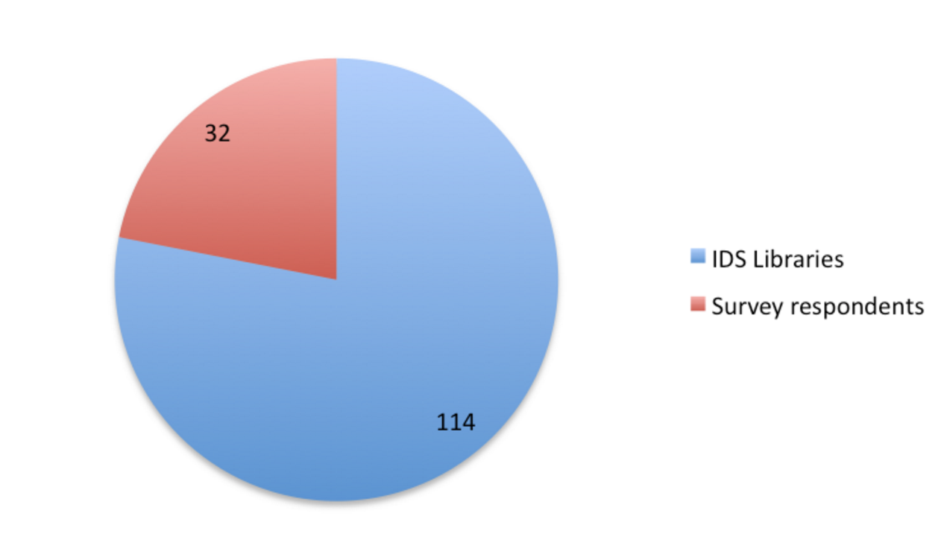
Response Rate
29 New York State Libraries 3 IDS Expansion Libraries
Notes:
Out of the 114 IDS Libraries, 32 responded and 29 were NYS Libraries

Slide 6
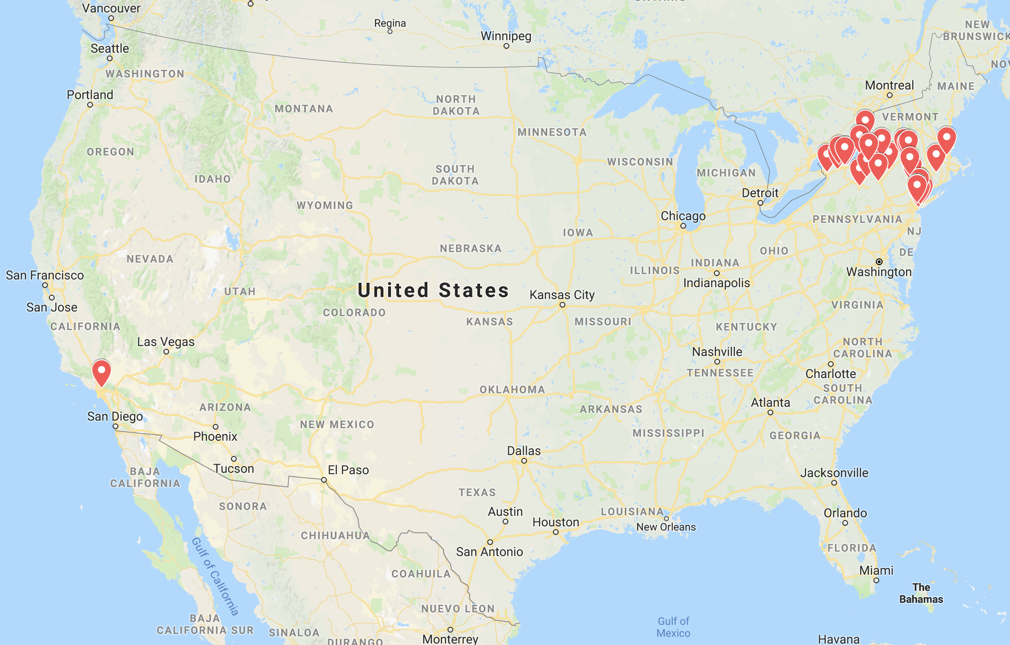
Where Responses Came From

Slide 7
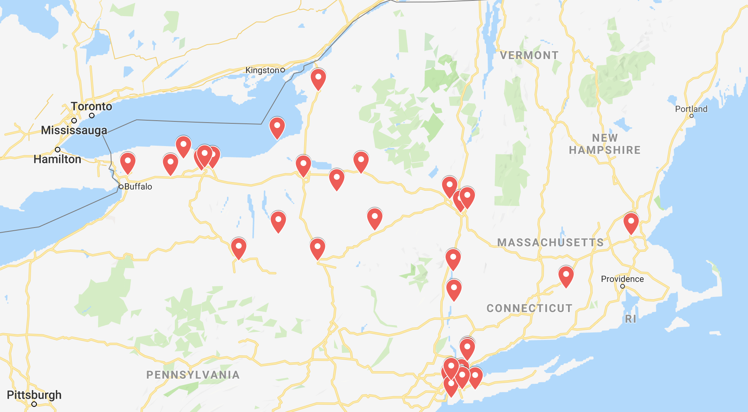
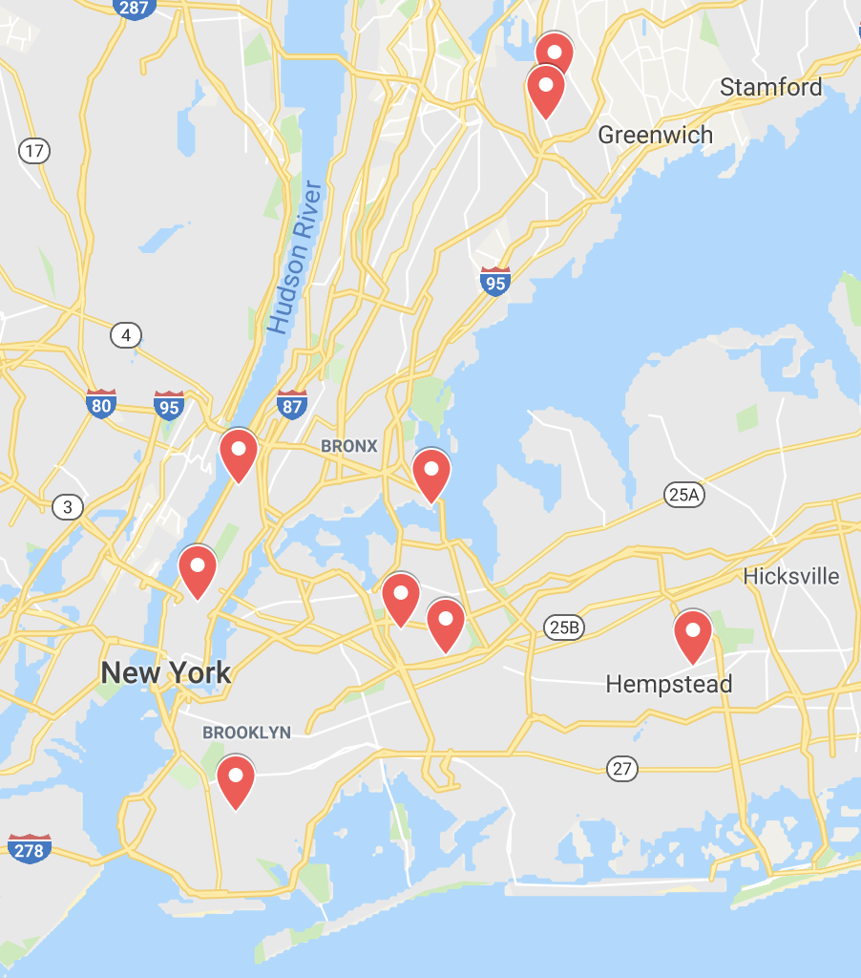
Where Responses Came From

Slide 8
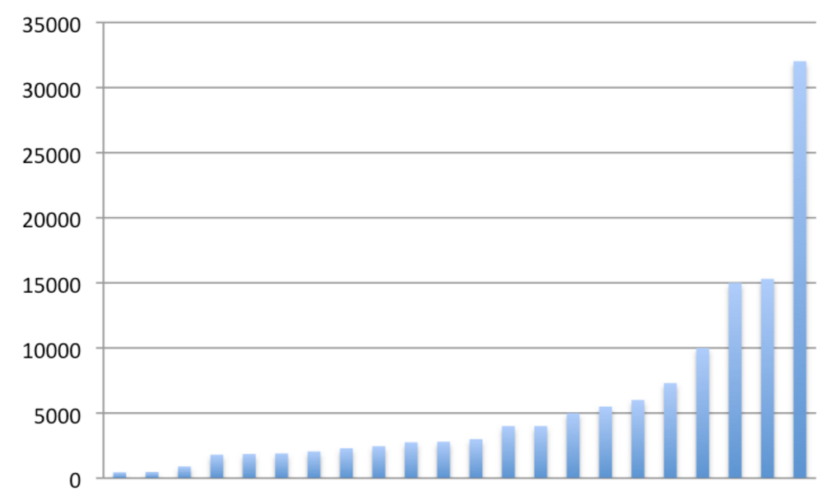
Full Time Equivalent Students of Respondents
Note: Based on some of the responses received, this question was written in a way that was not understood by all respondents.
This referred to the population of students studying at a college.
Only answers that fit this definition were included.
|
450
|
32,027
Median = 2,900

Slide 9
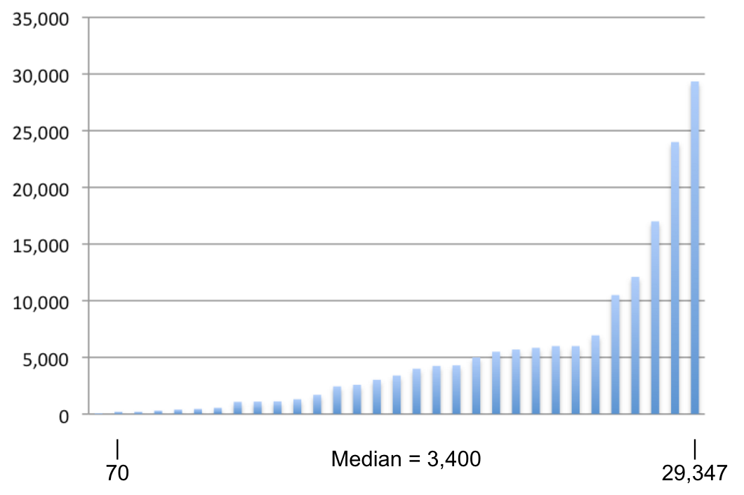
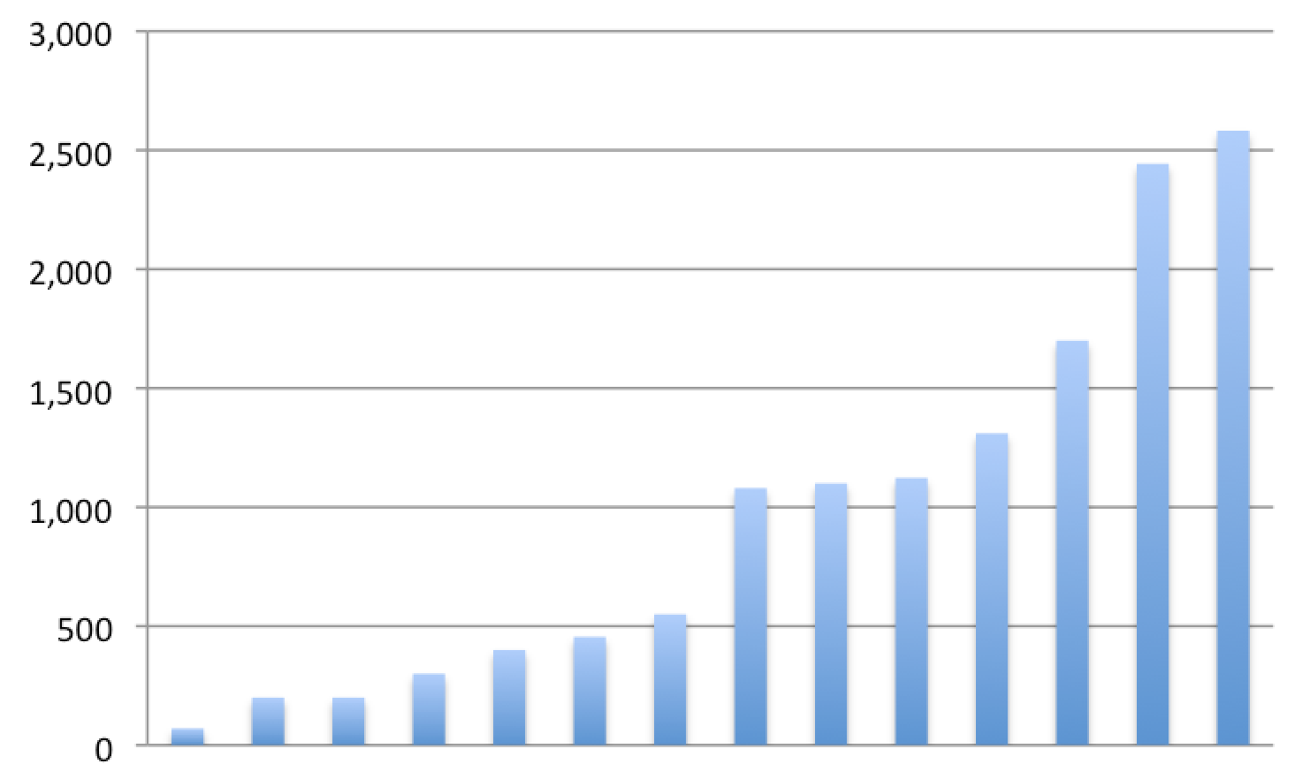
Annual Borrowing Requests
Notes:
Smaller graph - smallest amounts

Slide 10
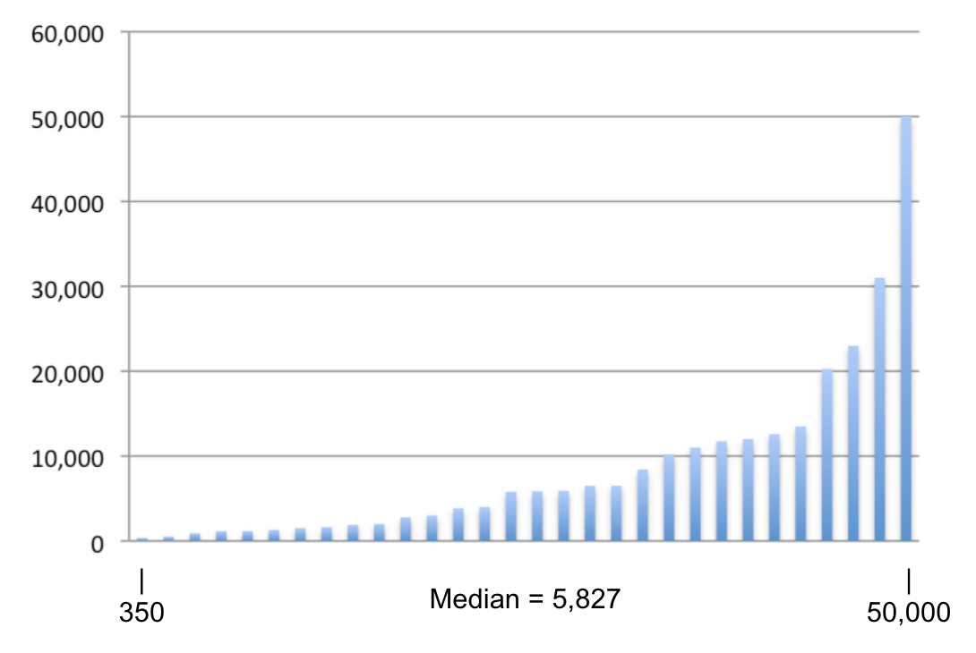
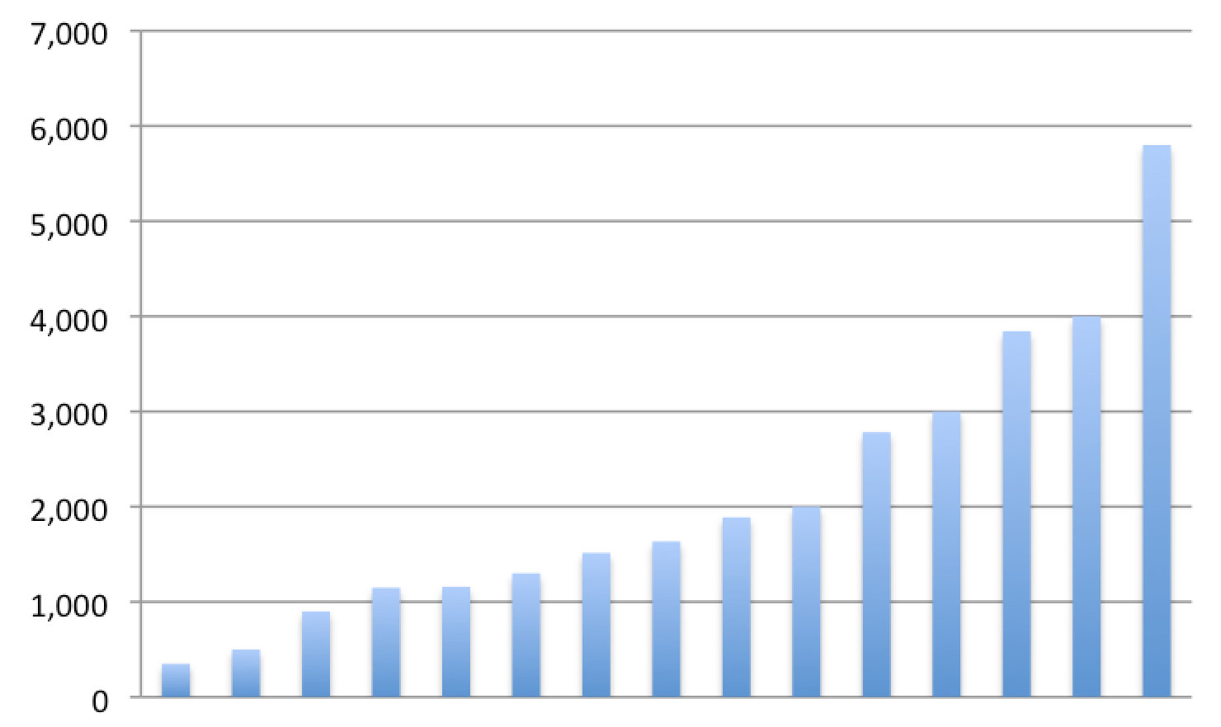
Annual Lending Requests
Notes:
Smaller graph - smallest amounts

Slide 11
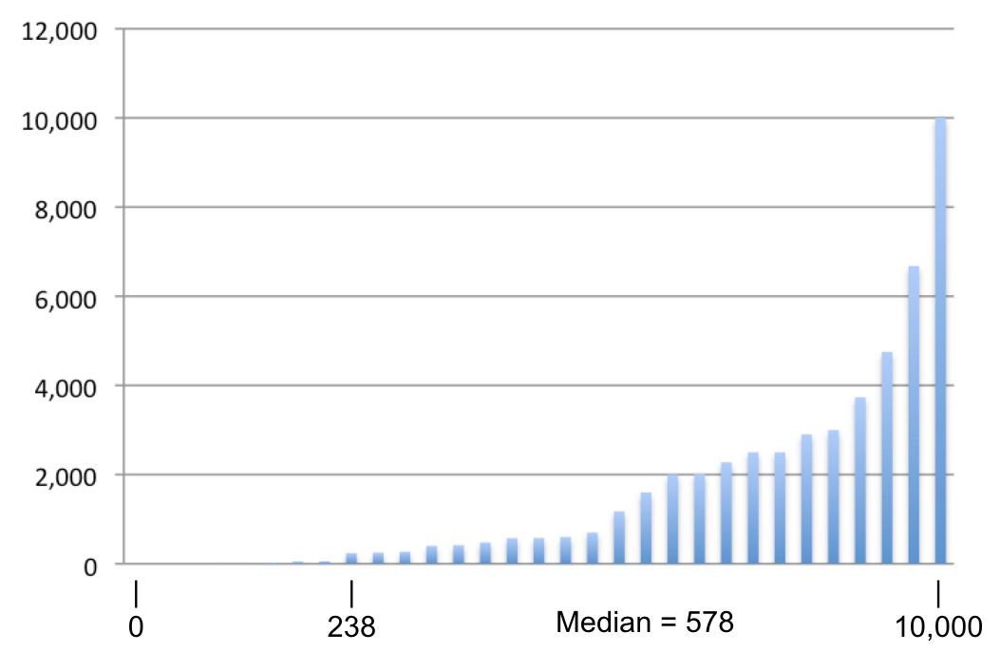
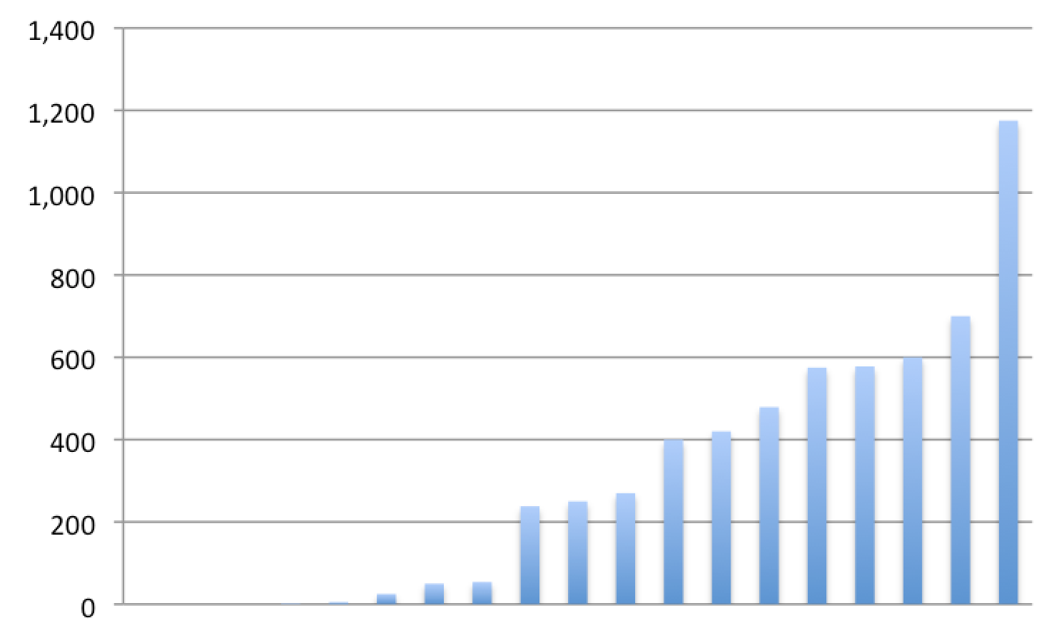
Annual Document Delivery Requests
Notes:
Smaller graph - smallest amounts

Slide 12
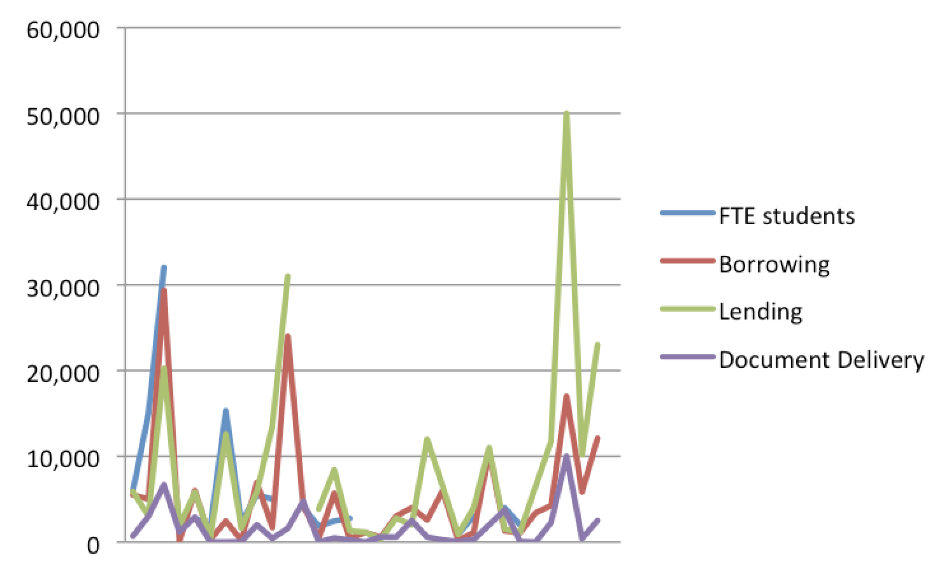
Comparison of FTE, Borrowing, Lending and Doc Del
Notes:
This slide isn’t super important but it’s interesting! Comparison of borrowing, lending and doc del requests based on student FTE for overall college. Not all respondents answered all questions, but there still seems to be a relationship between enrollment and number of requests.

Slide 13
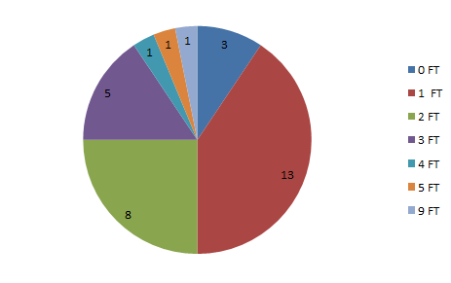
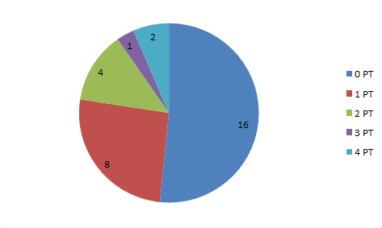
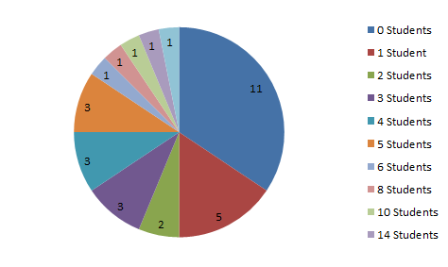
Number of employees
Full-time employees
Part-time employees
Student assistants

Slide 14
Types of training
The Question: “Please tell us what programs you use to create training material”.
Notes:
One of the last questions we asked was:
Please tell us what programs you use to create training materials….but maybe we could take a step back and review what types of training there are.

Slide 15
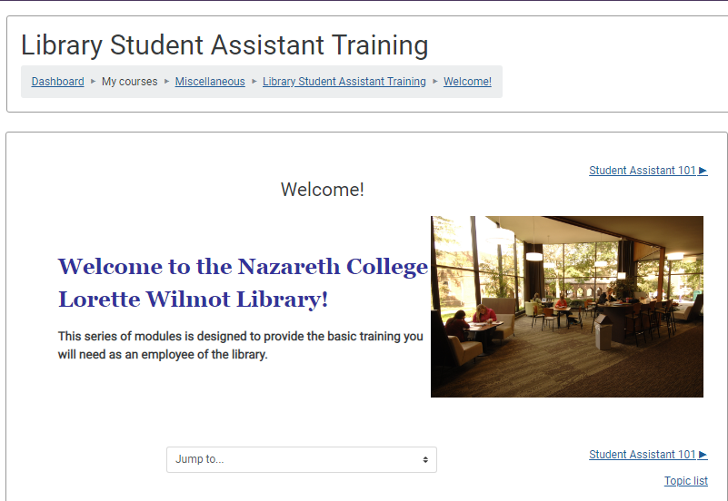
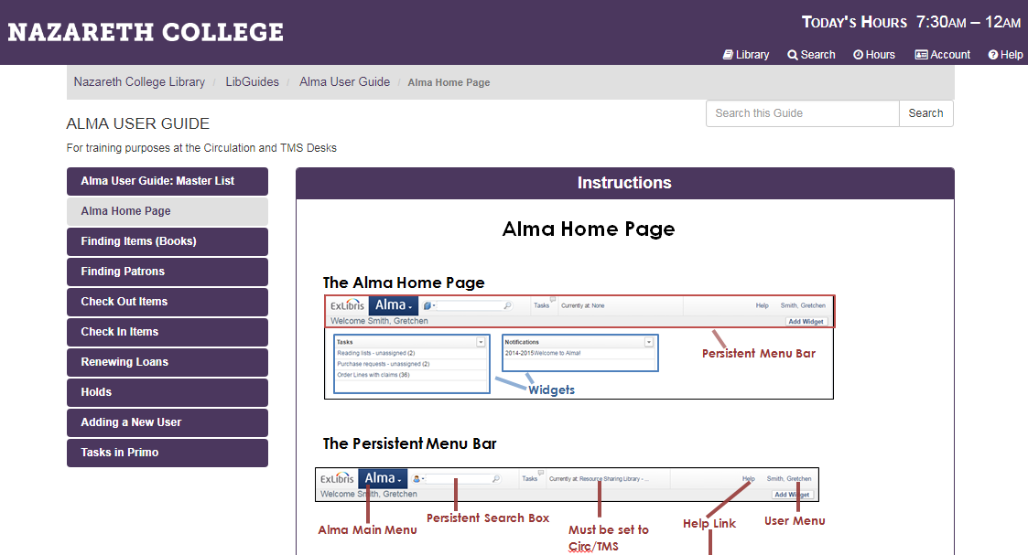
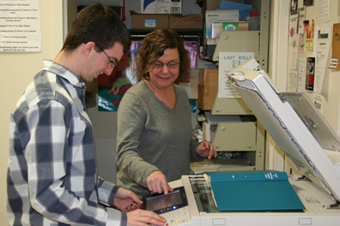
Types of training
Group
One-on-one
LMS
Lib Guides
Notes:
There are various methods of training managers can employ. And each method comes with pluses and minuses. Here are just a few EMPLOYED at NAZARETH COLLEGE
Group -
PLUS:
This is a good method to use when you have a large number of employees you need to get up to speed quickly on the basics - policies, procedures for employees in your library, a library tour perhaps?
Everyone gets the same message.
MINUS:
Students or employees can get information overload if sessions are too long.
Some of your employees and the details may get lost in the training session and/or not want to ask questions in a big group setting.
One-on-One
PLUS:
Individualized instruction
Hands-on
Ability to performance check and correct
MINUS:
If you have a number of employees you are training this way, you ‘ll need a way to track who was taught what task.
Takes a lot of time
Learning Management System - Blackboard, Moodle, Canvas AND LibGuides
Both are used in similar manners and both have like pluses and minues
PLUS:
Same message
Employees can work their way through it
Ability to hyperlink to other documents and pages
MINUS:
Less Personal - face to face lacking
If tasked based - is it really the employee being trained doing the work?

Slide 16
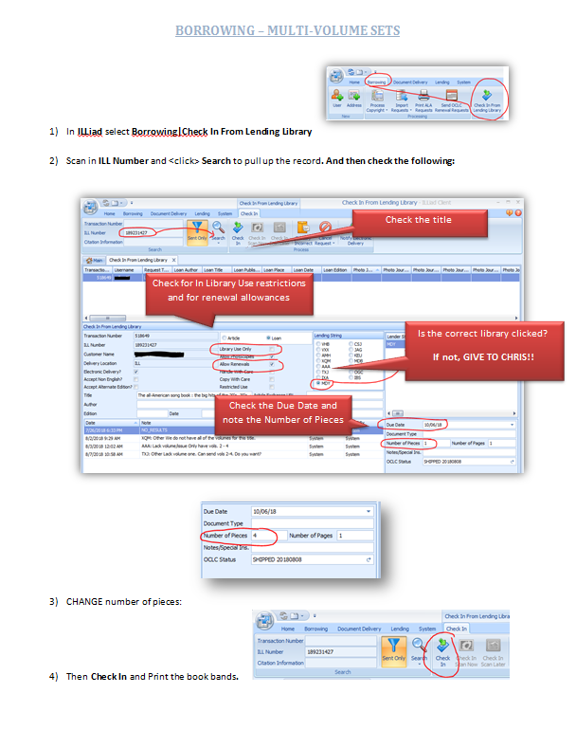
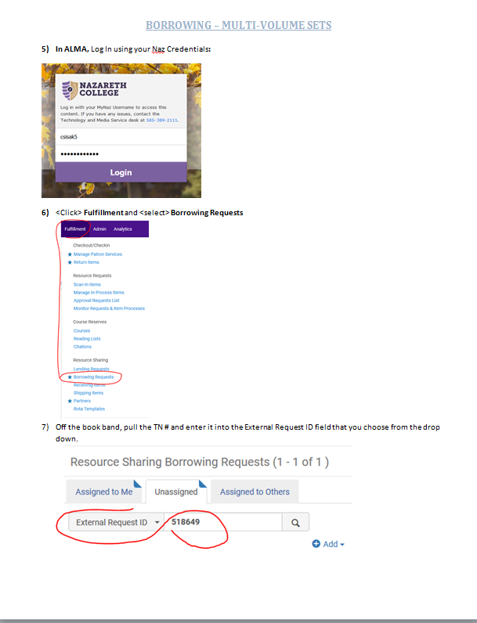
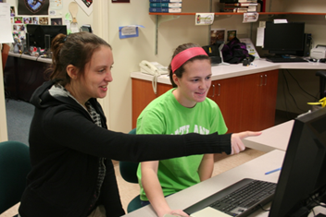
Types of training
Peer-to-peer
Crib sheets
Training Videos
Tip of the Week
Notes:
4) Peer-to-Peer
PLUS:
Learning can be taught by more experienced student employee
New student can relate to older student - the “I know where you’re coming from’
More relaxed - new student more likely to ask questions
MINUS:
How well trained is the trainer??
5) Crib Sheets
PLUS:
Great for visual learners.
Can place them in proximity to the task
Place for more screenshots, less text
MINUS
Can get misplaced by accident.
6) Training Videos
PLUS
Another great example for visual learners.
Allows for demonstrating the task and replaying the task
MINUS
Takes time to make these
7) Tip of the Week - post these to the walls, in a weekly email to employees, in your employee blog. Plus side - they read it and reaffirm or learn something new. Minus side - they don’t read it.

Slide 17
Types of Programs Used to Create Training Material
Microsoft Office
One Note, Powerpoint, Word
Create paper workflows and guides
Step-by-step instructions
LibGuides
Atlas Video Library
Individual laminated one-sheet guides
Don’t really have formal training materials
Because our department handles so many things we are all cross trained on Circulation, Reserves, inventory, access, and we process archives and maintain the Rare books collection. Both ILL employees handle both Lending and borrowing and students handle book retrieval and packaging
Most of our training is hands on, although we have created "cheat sheets" to assist in the training process.
All of our documentation is in Microsoft OneNote. We have sections for borrowing, lending, Alma fulfillment, Rapid exports, processing invoices, etc
Face to face training

Slide 18
Types of Cross Training from the Survey
Employees cross training (29 out of 32 responded to that question)
Within ILL department
Lending
Borrowing
Document Delivery
Other library service desks
Because our department handles so many things we are all cross trained on Circulation, Reserves, inventory, access, and we process archives and maintain the Rare books collection. Both ILL employees handle both Lending and borrowing and students handle book retrieval and packaging
We are a small library so everybody needs to be trained in a variety of areas
Employees are only cross trained within the department (lending/borrowing)
ILL and Circulation (Borrowing) are cross-trained.
Notes:
Examples :
WITHIN THE ILL DEPARTMENT:
Employees are only cross trained within the department (lending/borrowing)
One recently starting switching clerks between borrowing and lending so they are fully trained.
OTHER LIBRARY SERVICE DESKS & DEPARTMENTS:
ILL and Circulation (Borrowing) are cross-trained.

Slide 19
Types of Cross Training from the Survey
Employees cross training (29 out of 32 responded to that question)
Other library departments
Other comments
Cross training is currently minimal, however, we are going to be more widely cross training in the next six months.
There is little actual cross-training (involving interlibrary services). We try to educate other staff using mass emails and the library's intranet.
Because our department handles so many things we are all cross trained on Circulation, Reserves, inventory, access, and we process archives and maintain the Rare books collection. Both ILL employees handle both Lending and borrowing and students handle book retrieval and packaging
Notes:
Examples :
OTHER LIBRARY SERVICE DESKS & DEPARTMENTS:
Because our department handles so many things we are all cross trained on Circulation, Reserves, inventory, access, and we process archives and maintain the Rare books collection. Both ILL employees handle both Lending and borrowing and students handle book retrieval and packaging
Everyone in ILL also works circulation. And do rotations working over at the reference desk. The only things we don't do is tech services stuff. Our primary ILL people have aspects of ILL that they focus on, but everyone is trained to process any kind of request for when others are out of work.
OTHER COMMENTS:
Cross training is currently minimal, however, we are going to be more widely cross training in the next six months.
There is little actual cross-training (involving interlibrary services). We try to educate other staff using mass emails and the library's intranet.

Slide 20
Types of Cross Training from the Survey
Student workers
Within ILL department
Lending
Borrowing
Document Delivery
Other library service desks
Other library departments

Slide 21
Sources for Training & Supervising
Notes:
Two great sources for Training and Supervising particularly student employees are: Effective Management of Student Employment and the Supervising Student Employees in Academic Libraries. Both offer a lot of great policies and procedures as well as other information regarding supervising students. If you don’t own them –ILL them!

Slide 22
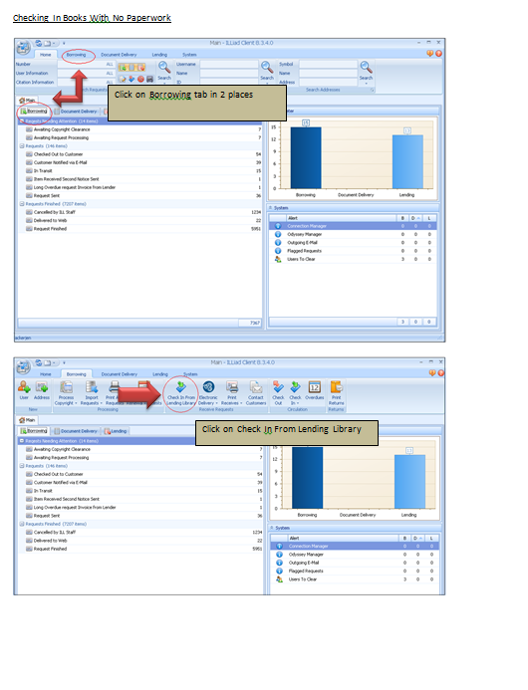
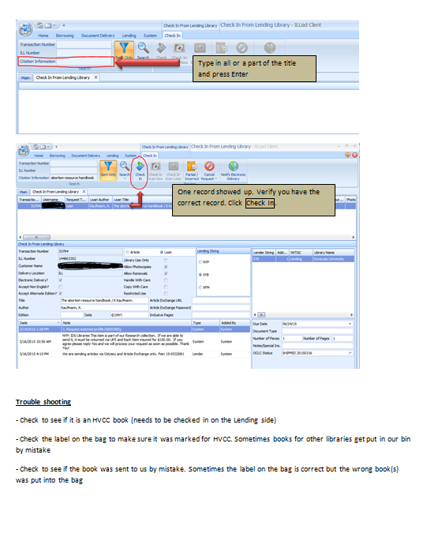
Training example - Hudson Valley Community College (VXV)
Notes:
Dropbox - https://www.dropbox.com/sh/wpr0h64ndn3u9o3/AAB2YlmuHOMX4nABjwYS2uGIa?dl=0
Screenshot based

Slide 23
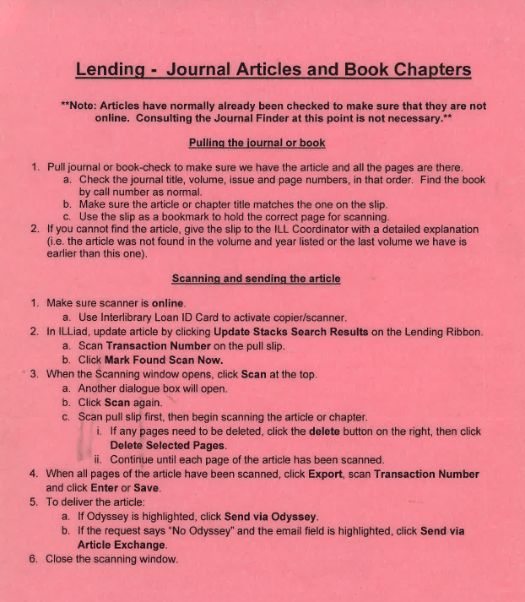
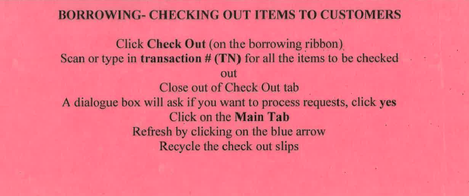
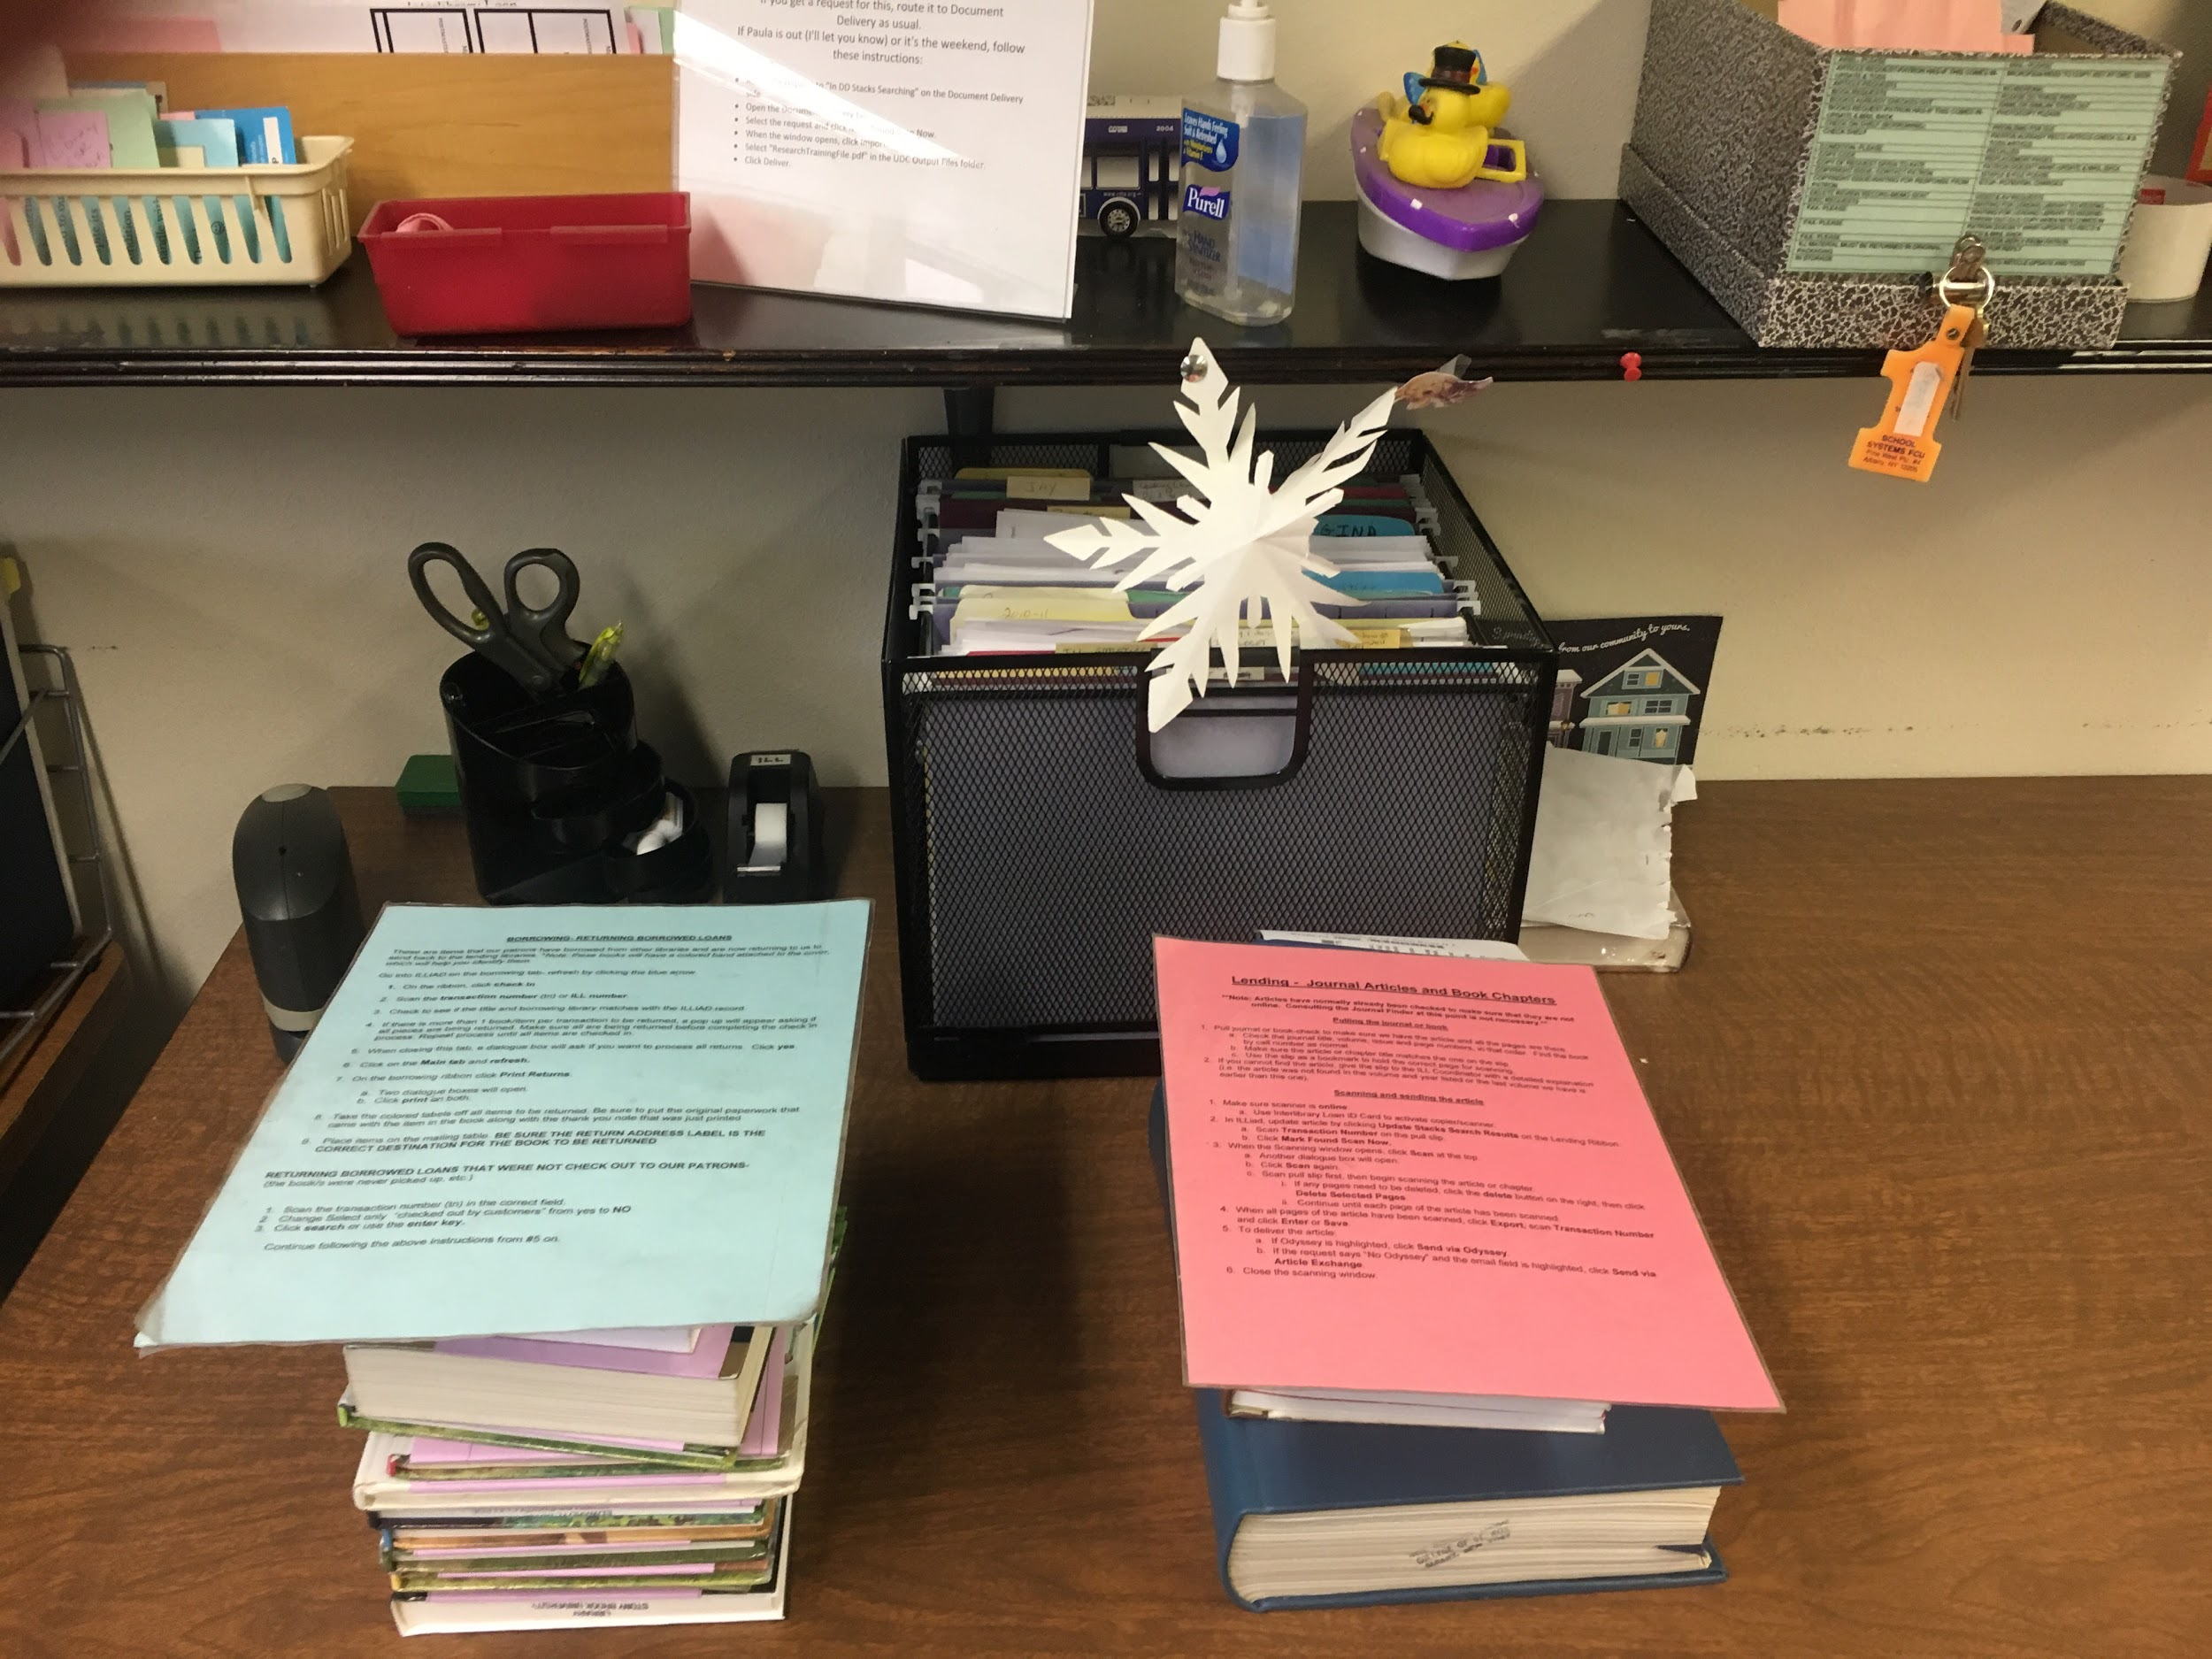
Training example -
The College of Saint Rose (VJN)
Instruction cards also function as task labels.
Notes:
All in text. Cards also function as task labels, for full-time, part-time and student assistants.
St. Rose example in DropBox folder.

Slide 24
A special thank you to all who responded to our survey.
Questions? Comments?
Marta Ambroziak - marta_ambroziak@nymc.edu
Jay Kibby - kibbyj@mail.strose.edu
Christine Sisak - csisak5@naz.edu

