Slide 1
Welcome Fall Eastern User Group! October 19th, 2018

Slide 2
Welcome Fall Metro User Group! October 4th , 2018

Slide 3
Welcome Fall Western User Group! October 15th, 2018

Slide 4
Membership Growth

Slide 5
What is the Article Gateway?

Slide 6
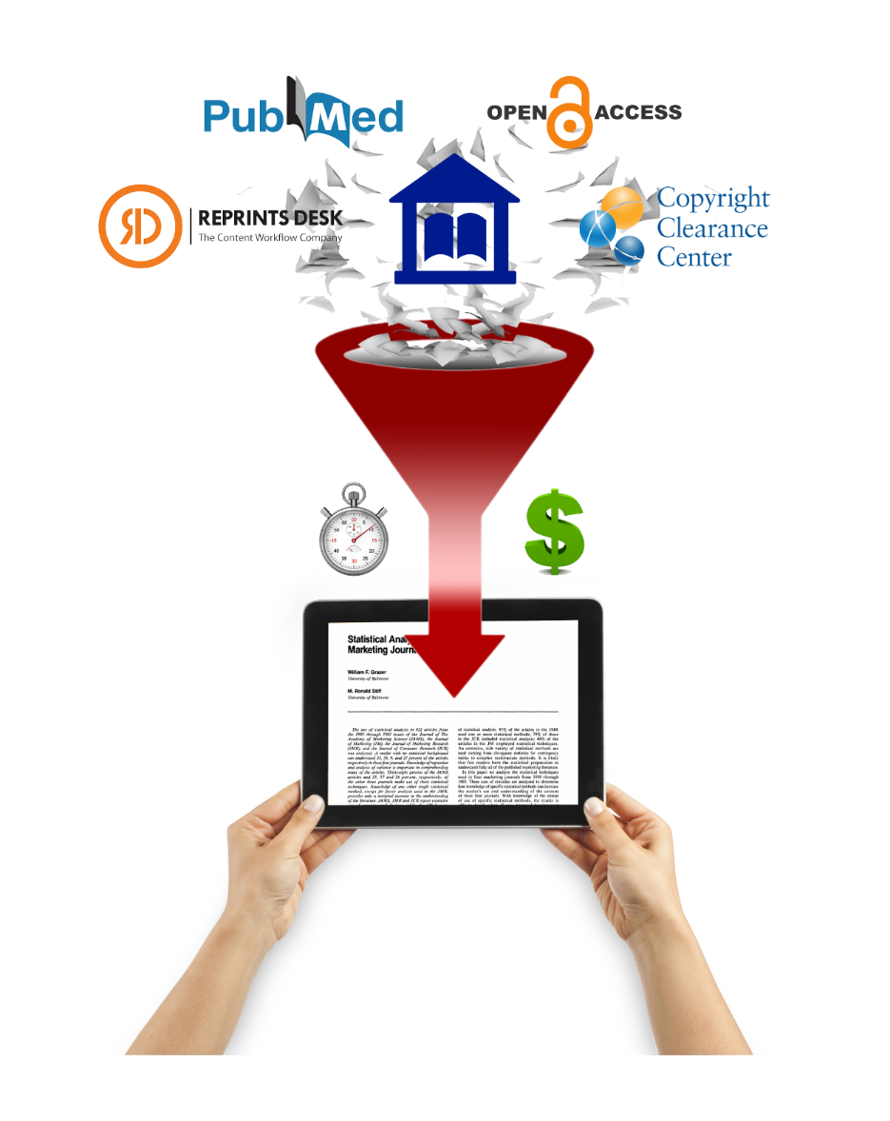
Article Gateway is an article provider platform and decision configuration center.
Depending on library preference, multiple sources and vendors can be integrated.
Notes:
The main point is that Article Gateway is a platform focused on article delivery in the most efficient way that is configurable for the library’s specific needs and abilities. Currently, Article Gateway focuses on comparing resource sharing and purchasing, but will be developed further to continue to meet library needs.

Slide 7
The Effect of Article Gateway at University at Albany
Turnaround Time
Spring 2016 (pre AG) – 1.58 days
Fall 2016 (post AG) – 0.91 days
Average of 16 Hours Faster

Slide 8
The Effect of Article Gateway at University at Albany
5,700 (67%) citations completed or fixed
Copyright Not Required 6823 (92.1%)
Copyright Required – 589 (7.9%)
Lowest price determined
Notes:
I think we should just combine the two slides to show just the roughly 5200 requests automated

Slide 9
Tipasa and IDS

Slide 10
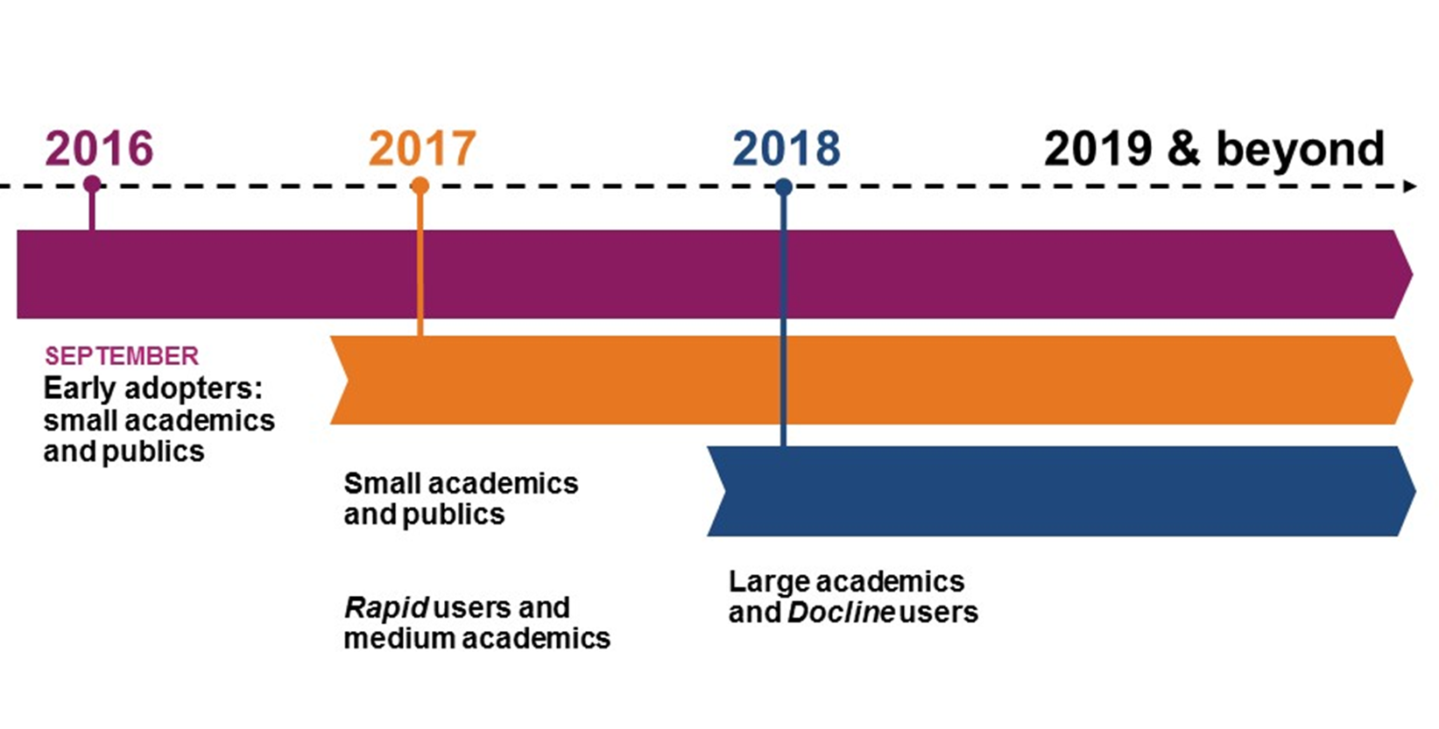
IDS Project Libraries

Slide 11
Tipasa APIs
API Taskforce:
Tim Jackson, Shannon Pritting, and Mark Sullivan represent IDS
First meeting was 9/19/2017
API Workforce:
OCLC will be publishing API documentation for Tipasa
Mike Mulligan will be working with API development group to develop APIs
OCLC Devconnect will going Online for workshops
People not the Platform

Slide 12
Alma and IDS

Slide 13
Over 80 libraries in IDS will be on Alma by 2019
NCIP for ILLiad and Alma
Logic for Alma
Middleware solution for Alma and Tipasa
In process of learning Systems and Resource Sharing for Alma
Exec Director part of Alma Systems Group
IDS Logic Team part of Alma Resource Sharing Group
Talking with Ex Libris about Resource Sharing options

Slide 14
Thank you!
https://github.com/idsproject

