Slide 1
Reserves workflows and processing
Spring 2019 IDS Project RUGs
Shannon Pritting
Shared Library Services Platform Project

Slide 2
Basic Breakdown of Reserves Processing: 4 Main Steps
Create a course
Create a reading list
Add citations to reading lists
Move items to Reserves Location if needed
SUNY FAQ that you may want to edit/use as a baseline for your campus documentation:
http://slcny.libanswers.com/faq/248322

Slide 3
The Course Reserve Hierarchy/Flow
https://knowledge.exlibrisgroup.com/Alma/Product_Materials/050Alma_FAQs/Fulfillment/Course_Reserves

Slide 4
Roles Needed
Course Reserve Manager (to create courses)
Course Reserve Operator (to add/edit reading lists)
Fulfillment Operator (to manage the move request)
Request Operator—scoped to library
If you’ll have different people processing reserves, you may want to create a course reserves profile so you don’t have to add these roles manually.

Slide 5
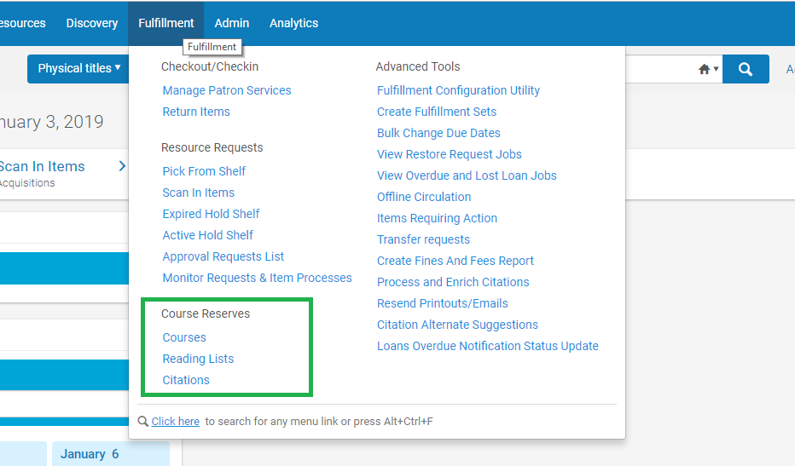
Step 1: Creating a Course

Slide 6
Courses Screen

Slide 7
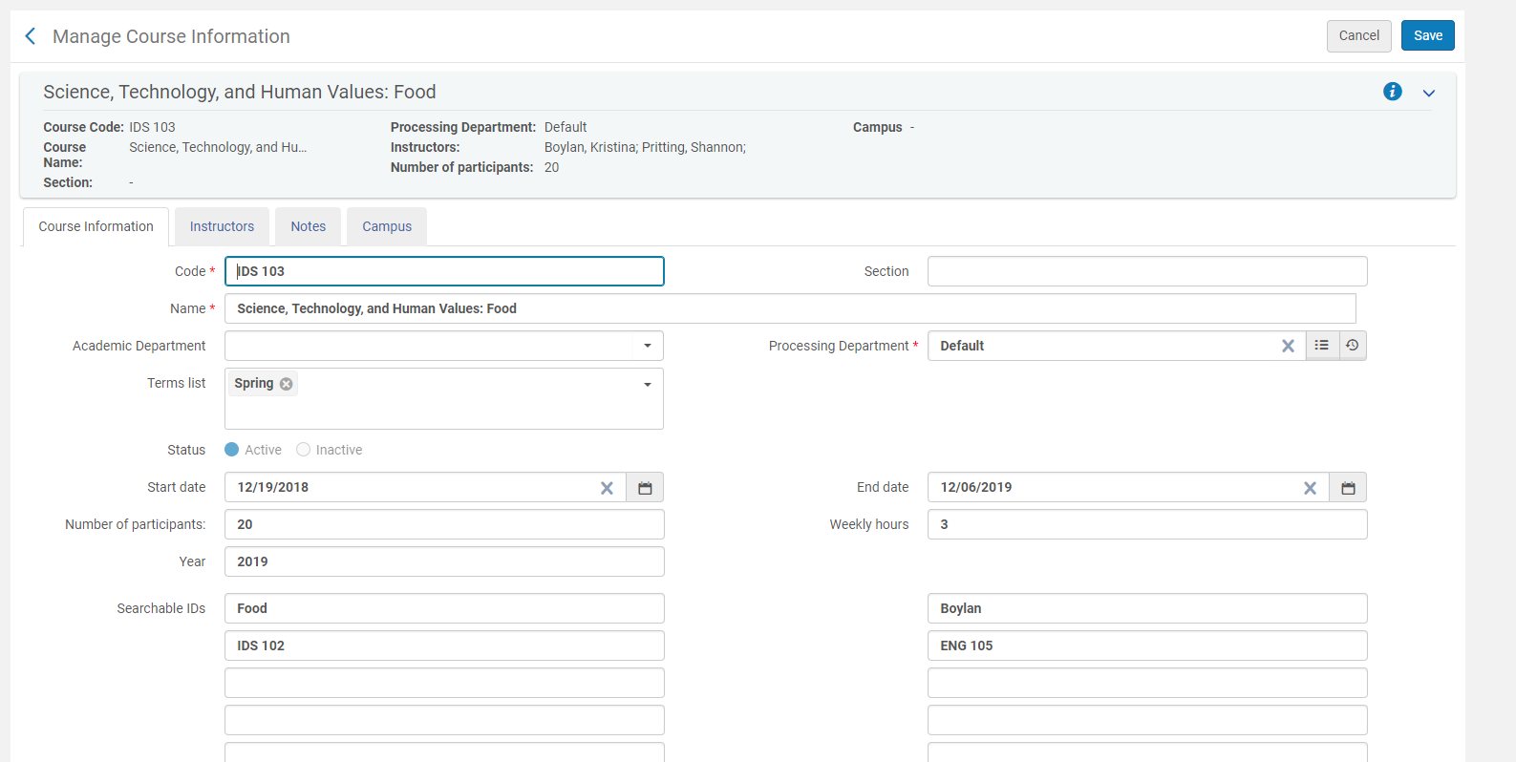
Manage Course Information Screen

Slide 8
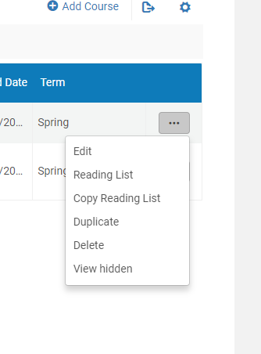
Step 2: Add Reading Lists

Slide 9
Reading List Menu in Course

Slide 10
Add Reading List Screen

Slide 11
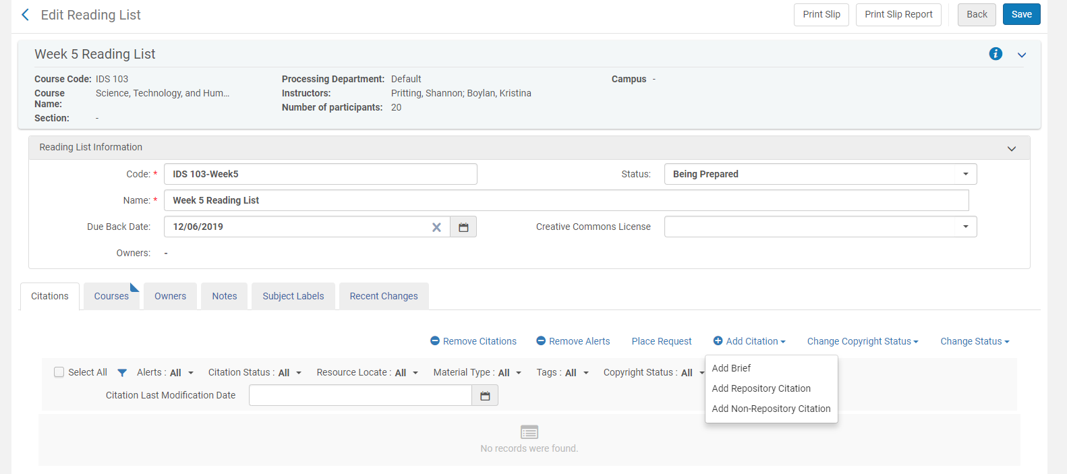
Add Citations in Edit Reading List Screen

Slide 12
Repository Search for Adding Citations

Slide 13
Workflow Decison—To Place the Request or Complete from Here?

Slide 14
If you select Place Request, You’ll need to Create Request

Slide 15
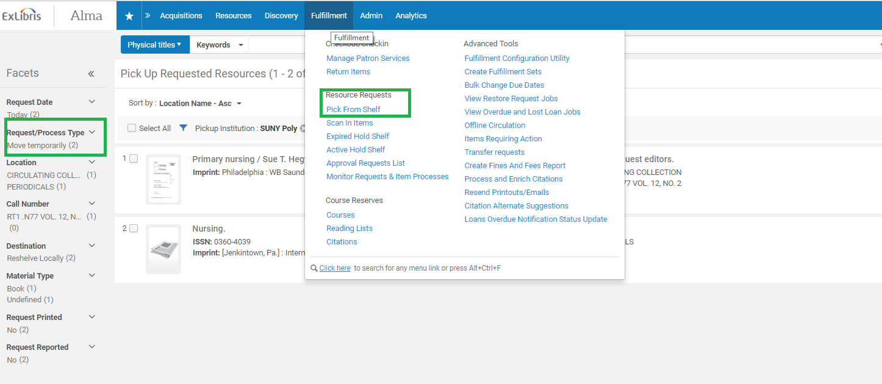
Requests Must be now “Picked from Shelf”

Slide 16
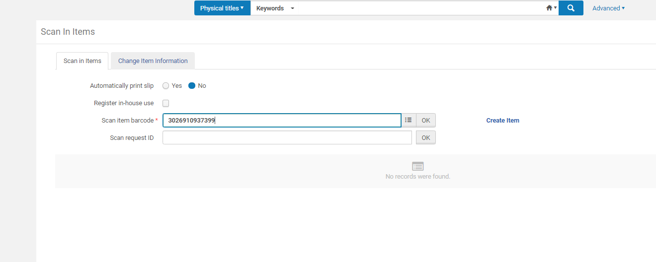
Scan in Items to Complete the Move

Slide 17
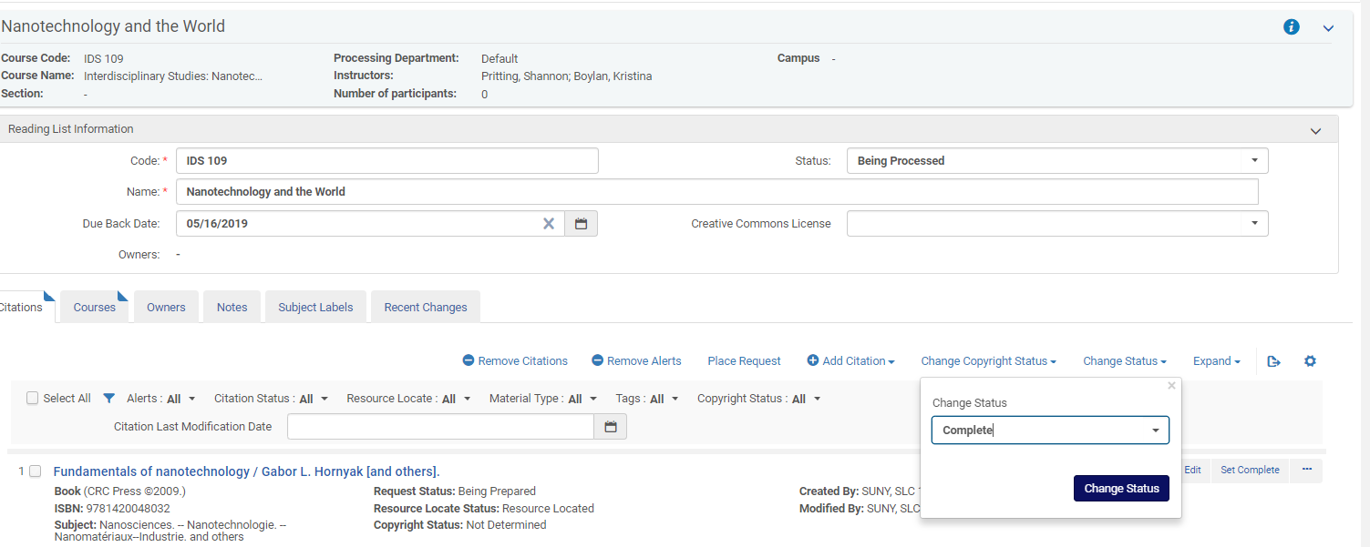
Now, we just need to finish the Reading List

Slide 18
Done Now (but don’t make this workflow if it doesn’t work for you).
Alma and its workflows are developed to serve many types of libraries.
If you do all the work, you may be able to cut steps and gain efficiencies.
Just make sure you keep track of the main actions that need to happen:
Item is in appropriate location for TOUs to be applied.
Item is in a reading list that is attached to a course.
The course and reading lists have appropriate start/end dates.

Slide 19
Demo adding a course, reading list, and items
Please Follow Along in Alma

Slide 20
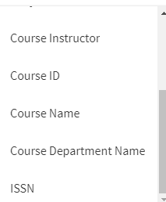
Final QA process: check Primo
Testing the indexes for courses, names, departments, and instructor information is a good way to make sure your course information worked.

Slide 21
Check for Correct Locations
Primo can provide a good way to skim to make sure all the items are appropriately moved to reserves location as well.

Slide 22
Questions and Sharing
Have you worked out a streamlined approach for reserves processing?
General Questions?

