Slide 1
Customizing alma Letters and notices
Spring 2019 IDS Project RUGs
Shannon Pritting
Shared Library Services Platform Project

Slide 2
Thanks
Thanks to Pam Tejes from ExLibris for sharing slides.
And, thanks to Tao You from Vanderbilt and Tim Siegel from VCU for re-use of some information/slides from their recent ELUNA presentation, “

Slide 3
Overview and Approach
Most complex systems have complex printing and notice configuration that initially takes a while to get used to.
ILLiad and its print templates, notices, and overdue emails.
Aleph/Voyager and its complicated notice/printing structures
Worldshare and its slips.
In the grand scheme, letters and notice editing in Alma aren’t terrible—but it’s a lot to take in all at once.
Notices are important, as they’re a major part of our interaction with users.
Printing is also important, especially for access services, as this can streamline pulling from shelf, shipping, etc.
You can make improvements with varying levels of expertise—so don’t worry if you’re not ready to dive into XSL/XML editing.
Completely changing letters and notices probably isn’t something that is possible without local XSL/XML expertise and institutional commitment.

Slide 4
Get your hands dirty, or keep them clean.

Slide 5
Reminder that SUNY’s still in Implementation.
If you haven’t already done this, for printing:
Create a fake e-mail for printing/printer and add to appropriate circ. desk.
Add to allowed emails
If you haven’t already done this for emails:
Unscrub e-mail for the user you’re testing with.
Add the e-mail to the allowed e-mails table.

Slide 6
How do letters and notices work?
Slide credit: Tao You, Vanderbilt, Tim Siegel, VCU

Slide 7
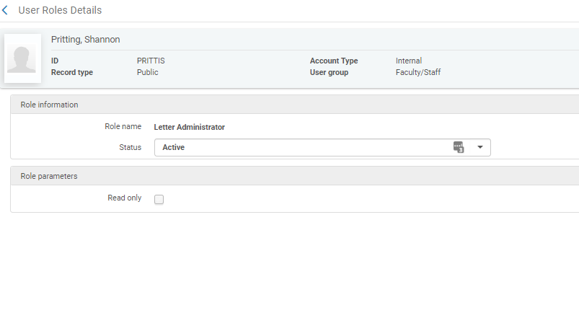
What Roles do you need?
Letter Administrator or General System Administrator
If you think your library will be reluctant to give you letter admin, ask for the role with the parameter of:
Read Only

Slide 8
Types of Letters: Staff Printouts
System Job Letter
Citation Slip
Used to retrieve course reserve items from shelves
Resource Request Slip
Used to retrieve items from shelves to fill requests
Best source on letters & what they do:
CKC page “Configuring Alma Letters”

Slide 9
Types of Letters: Notices Sent to Patrons
Examples:
Notifications
Courtesy Notice sent when item can’t be renewed or when item is due
Overdue and Lost Loan Notices
Notice that item needs to be returned
Notice that item was declared lost and patron charged
Others:
Loan/Return Receipt Letters
Borrowing/Fulfillment Activity Letter
On Hold Shelf Letter
Cancel Request Letter
Loan Status/Change Due Date Letter

Slide 10
How Do I know what is sent to patrons?
FAQ categorizes patron facing jobs.
From those that are patron facing, you can determine which ones you will/won’t use.
Jobs or actions that trigger the notice are listed as well.
You can narrow down the list much more.
http://slcny.libanswers.com/faq/263578

Slide 11
The letter customization toolbox
Using the right tool for the job.

Slide 12
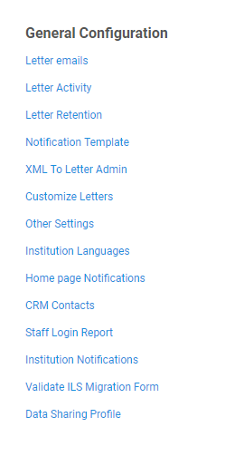
The Alma Letters Toolbox
XML to Admin
Letters Email Code Table
Nested code tables that allow editing of content
Notification Templates
Generates XML of letters so you can see how letters are built
Customizing Letters (editing XSL)
Change the style and content flowing into letters.
Letter Activity
Turn letters on and off at a system level. Because why edit if you don’t want to use it?

Slide 13
Alma Letters: Structure and Display
Slide credit: Tao You, Vanderbilt, Tim Siegel, VCU

Slide 14
XML to Letter Admin
Only letter admins/general sys. admins can be an “XML Receiver”
Subscribe to letters and will get copy of letter and the xml via e-mail.
Good way to get the xml/xsl sent for specific notifications without going into the customize letter interface.
Frown face: have to trigger event/job to send yourself the XML/XSL.

Slide 15
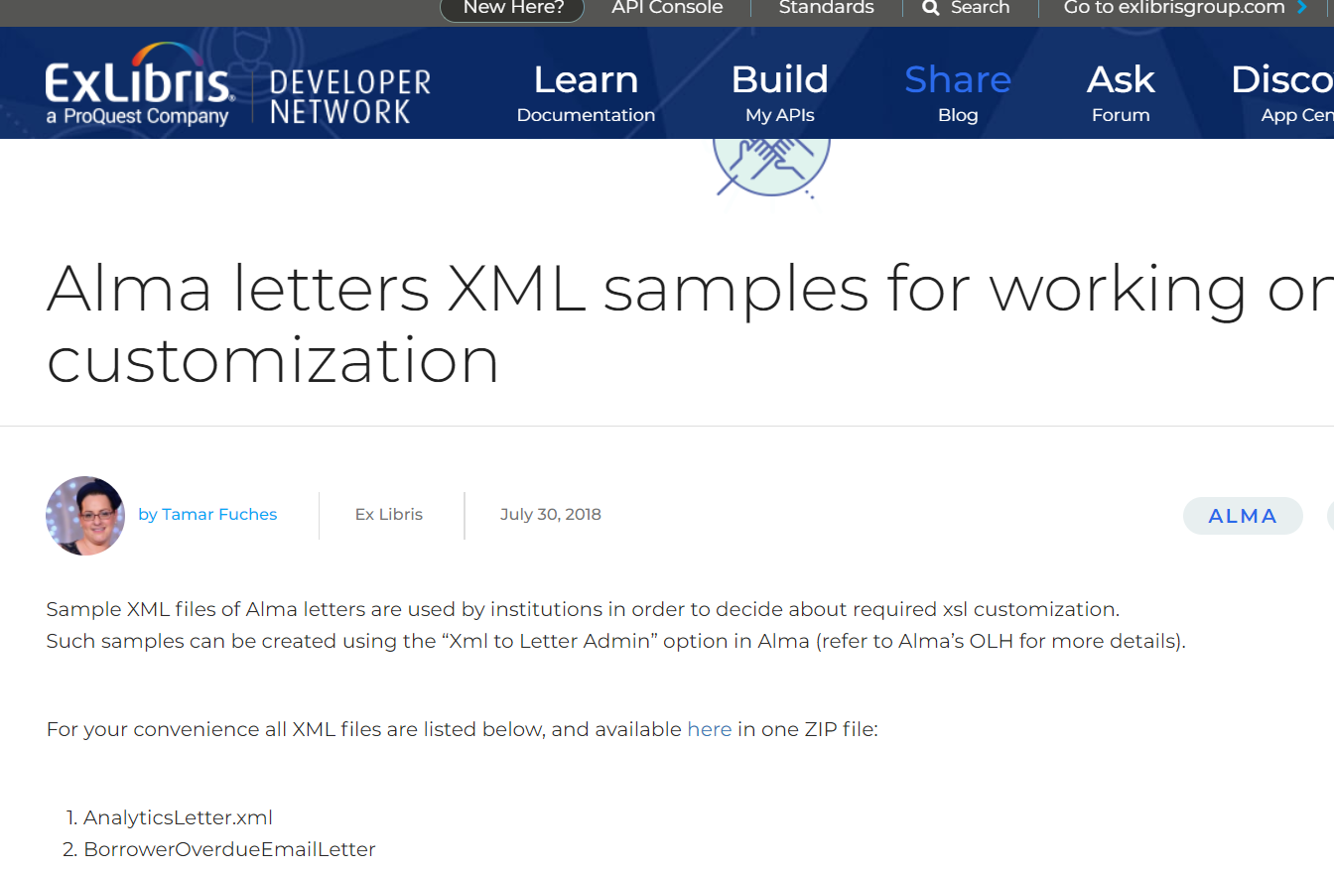
Pro-Tip: Get the Sample of the Letter if you don’t want to mess with generating in Alma.
Obtain sample XML letters from Developer’s Network (Zip File of all XML for letters).
Make changes to XSL (Customize Letters)
In Notification Template, upload the XML
https://developers.exlibrisgroup.com/blog/alma-letters-xml-samples-for-working-on-xsl-customization/

Slide 16
Notification Templates
Can upload xsl/xml and trigger the letter to be e-mailed to you or will show you both the letter and the xml as a browser pop-up (remember to turn off pop up blocker).
The file should tell you what template it’s using.
Great way to troubleshoot and test your letter without actually saving your customizations.

Slide 17
Run XSL in Notification Templates will let you know if there are issues.
Run XSL will apply XSL to the letter XML.
Good debugging tool and let you know if there are issues in your xsl.
Notes:
Ful Place On Hold Shelf Letter—edit the circulation desk.
notification_data/request/assigned_unit_name

Slide 18
Editing Global Information: Footers and Headers
Many letters call headers and footers.
You can change what’s pulled from these headers and footers, or add/remove things from the header/footer.
Ex: Adding My Account and Contact Us
Notes:
<xsl:call-template name="myAccount" />
<xsl:call-template name="contactUs" />
https://knowledge.exlibrisgroup.com/Alma/Knowledge_Articles/How_to_add_My_Account_and_Contact_Us_links_to_a_letter_footer

Slide 19
Looking at where the information is in the xsl.
Notes:
<xsl:call-template name="myAccount" />
<xsl:call-template name="contactUs" />
https://knowledge.exlibrisgroup.com/Alma/Knowledge_Articles/How_to_add_My_Account_and_Contact_Us_links_to_a_letter_footer

Slide 20
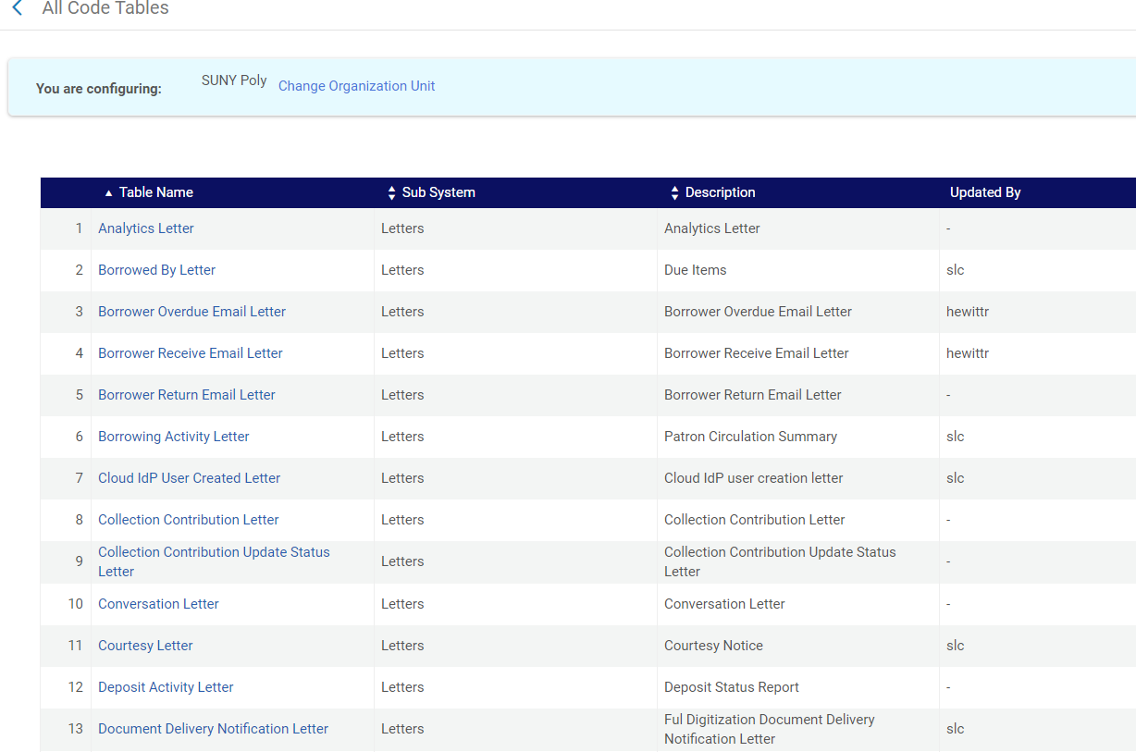
Letter Emails Customization
Can handle quite a bit of customization without being too deep into config.
Most difficult part is knowing the name of the letter/table.
Can change a lot of parts referenced in letter emails.
Can also disable parts of messages from being entered into emails.

Slide 21
Demo of editing a letter
Changing text in the letter and within the footer in customize letters.

Slide 22
Enough about tools, what about process?
Making it all connect

Slide 23
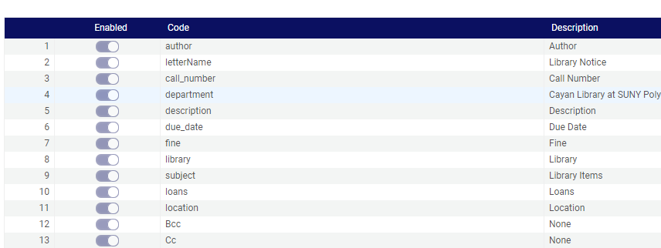
So, what if I want to change something on a letter? First Steps
Inventory what letters you want to use, or think you want to use.
Make a list.
Read what will send the letter
Trigger the action to create the letter (this is often a lot harder than it seems) to see if you want to change anything.
Or, subscribe to a variety of letters in XML to Admin as an XML letter receiver.
Add the bcc code in the Letter Code Table (only for patron facing letters).

Slide 24
Demo of customizing letter emails
Changing information in the letter without touching xsl/xml. Better known as the quick and clean method to edit notifications.

Slide 25
Next steps, how to change a letter if you don’t like how it looks?
Is it as easy as changing/customizing the code in the “Letter Emails” code table?
If not:
Get the XML Via XML to Admin (or start with a generic xml file)
Review the structure of the letter.
Find the xsl/xml that is problematic.
This may or may not be in the letter xsl, but may be in another file called in the letter.
Change the xsl and then test via triggering event/job.
Use XML to admin and notification template if you can’t easily send the letter via e-mail.

Slide 26
Get Your jobs right (if you don’t have an event)
Without a job, letters don’t go anywhere.

Slide 27
Fulfillment Jobs
Allows you to turn on/off jobs that trigger notices.
Can also trigger running jobs from here.
All scheduled jobs are turned off until go-live.
If you have notices that you don’t like at go-live, easy place to turn these off.
Due Date Calendar Change is likely something you want to turn off.
RS clean up jobs also exist here.

Slide 28
Letter Activity Table

Slide 29
Resource sharing slips and notifications
There’s really not that many…..

Slide 30
Main letters used for RS slips
LendingReqReportSlipLetter
A slip that is printed out by library staff for the selected requests in the lending task list that lists the availability of the items so that they can be taken off the shelf and shipped to the requester.
ResourceSharingReceiveSlipLetter
A slip that prints automatically when the Automatic Print Slip option is selected on Receiving Items. You may include a printable barcode image on this letter.
ResourceSharingReturnSlipLetter
Printable when returning a borrowing item to the lender. You may include a printable barcode image on this letter.
ResourceSharingShippingSlipLetter
Sent to a user when the user selects the Ship Item link for a lending request and then selects Automatically Print Slip = Yes on the Shipping Items page. You may include a printable barcode image on this letter.

Slide 31
Some notices related to resource sharing.
Ful Cancel Email Letter: used for ILLiad email integration
Ful Cancel Request Letter
Ful Renew Email Letter
Letters you may not want to use (and turn off the job?):
Ful Damaged Email Letter
Ful Lost Email Letter
General Message Email Letter
Lender Will Supply Email Letter

Slide 32
Questions and Comments

