Slide 1
Open Discussion
OCLC Resource Sharing Conference
Lending and borrowing policy changes with or without Alma
Other???
Flags - anyone??
How many ILL people are involved in Alma migration
Custom queues
Thoughts on shorter lunch
What Conferences do you attend, where, and why?
New ILL person - how do people split the work

Slide 2
Wrap Up
Spring 2018

Slide 3
Fall 2018
We are looking for 3 places for our Fall 2018 RUG meetings.
IDS Project pays for lunch
Need Wi-Fi
Room with a teaching console
Room needs to hold 20 - 35 people
No travel for you!!!
Notes:
If you think we could meet at your library please let me know and we can talk more to the powers that be at your library.

Slide 4
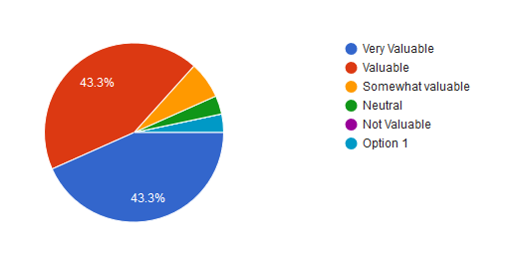
Fall 2017 Survey
16 of the 27 responses mention open discussion
- Networking and hearing what other libraries are working on. Their challenges and successes.
- Meeting up with colleagues and sharing about how to work through odd workflow issues we
all face.
- Sharing ideas face to face!
- I think they are important and add value to the membership. Gives us the opportunity to step
away and connect with others in the field, and learn about different topics.
- If you take away one thing to improve/streamline your service, then it was valuable!
- Building a network, sharing insider tips
- I find it useful to see IDS members in person and be able to discuss problems with them. I
also enjoy the short presentations, as even if I am familiar with the topic, there are often
one or two points I didn't know about.
Notes:
6 questions/30 responses

Slide 5
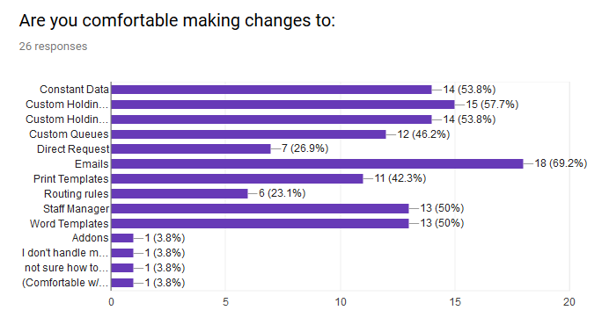
How can we help!!!
Notes:
This question is that you are comfortable with making changes with these topics. With the answers I got emails was the topic that most people felt comfortable making changes. Addons, routing rules, and direct request are some of the topics that didn’t get many votes. What would people like to learn about these topics? Any other thing about these topics?

Slide 6
ELD reminders
No delivery on Memorial Day, Monday May 28th
Report April Statistics by Friday, May 11th

Slide 7
Survey
I will send the survey link through Eventbrite!!!
Notes:
Please take a few minutes and fill it out!

Slide 8
OCLC Conference presentations
https://www.oclc.org/en/events/conferences/resource-sharing-conference/2018/agenda.html
Notes:
They are free to watch. Most of the Ball room presentations were recorded. The Keynote is one of them - worth watching!!!

Slide 9
All Region User Group Wednesday, July 25th
14th Annual Summer Conference is Thursday, July 26th and Friday, July 27th at the Utica College in Utica, NY.

