Slide 1
Tell Your ILL Story
Collecting & Using ILL Statistics
Collaborated by: Marta Ambroziak, Silvia Cho, Jay Kibby, & Sarah Shank
Notes:
Story about the cover:
Was looking for an oldish book to use for the powerpoint presentation, and was looking in the oversided section. There were a couple of books, but none really captured what I thoguth we would be looking for. Our oversized section is not all that far away from the PRs. I walked down an aisle and pulled out this item based on the interesting pattern on the spine. Coincidentally, there was a boat on the cover... seemed to scream "USE ME" for the IDS RUG Presentation.

Slide 2
Tell Your ILL Story
Collecting & Using ILL Statistics
Prepared for
Spring 2018 RUG Meeting
May 9th : Metro
Presented by: Silvia Cho
May 16th: Eastern
Presented by: Jay Kibby
May 22nd: Western
Presented by: Sarah Shank

Slide 3
Tell Your ILL Story
Contents
Preface: What makes a good story?
Chapter 1: Why
Chapter 2: Challenges
Chapter 3: What & when
Chapter 4: Where we gather Chapter 5: Practices
Chapter 6: Turning the Pages...

Slide 4
Preface: What makes a good story?
Answers all the Ws
Who?
What?
Where?
When?
Captivates audience
Humorous
Relatable
Serves a particular purpose
Informs
Entertains
Notes:
Before we start composing our ideas of how we create our own ILL stories, it might be important to identify what makes a good story in general. What does everyone think? [Open the conversation—let them shout a couple of things out—if they feel so inclined]. I have to preface this by saying that "I am not a literature expert", but I can share what interests me about a story.
As Resource Sharing practitioners, we certainly know how to tell stories to each other. Most of the stories that are shared on the ILL Facebook group for example are very relatable and even humorous. We can identify with them. We may use a story to relay information to our patrons. It may not only entertain, but it should give them some sort of information... How do we change our story for different patron groups? The story that interests a student may end up being very different than one that interests faculty members.
What about stake holders? The ones with the powers to add or detract from your service either by a monetary means or by decreasing available resources or staffing—what kind of stories do they want to hear? All stories should answer All the Ws...

Slide 5
Communicate with other Library Departments
Ref/Instruction; Information literacy needs
Acquisitions; Collection development needs
Communicate with Stakeholders
Show value of ILL Services
Advocate for ILL
Communicate with Peers
Help establish/support best practices
Support consortia membership
Help identify like/peer institutions
Share experiences
Chapter 1: Why?
Self-diagnostic Evaluation Troubleshooting
Consistent service
Workflows
Platforms/technology
Budget Management
Copyright price comparison
IFM & EFTS (Docline)
Purchase vs borrow
Discover Patron Needs
Improve user experience
Notes:
There are so many reasons we may collect data, and we probably have many stories to tell. The first couple are more internal to the ILL department: Who doesn't want to provide consistent service, improve workflows or get the best use out of their technology? We also spend a lot of time contemplating and working toward falling into budegetary norms. ILL data can help support price comparisons, purchase on demand (purchase vs. Borrow), and show how much we actually shell out per transaction. Lastly, we want to know what or how to continue providing the best service to our patrons. The next more intralibrary/campus/community depending on the type of library you are: Data can be one way of communicating with other library departments such as reference/instruction & Acquisitions/Collection Development. Finally, there are external reasons. Stakeholders were previously mentioned—maybe patrons that donate to the library, or those that hold the purse strings. Outside of the institution, we share data with each other. These stories help us all build best practices, gain insights from a different perspective, and just share experiences---our stories become teachable moments for others.
Could ask the audience here if they have examples of reports that they run that would help in each area?

Slide 6
Inconsistent data formats
OCLC Usage Statistics give pre-set period of time
Illiad allows for customization of time period
Uneven documentation
Illiad: web reports documentation
OCLC: Help Documentation (limited)
Lost in translation
Illiad vs Iliad
Difficulty communicating ILL specific data to non-ILL specialists
Chapter 2: Challenges
Lack of Time
Anyone? Have more hours?
No “Ring” to rule them all
Illiad users have multiple sources
Web reports
Custom reports/searches
OCLC Usage Statistics
Limited types of ready-made reports
Notes:
I am sure anyone can relate to the challenge of not having enough time. So much to do, so little time. Are any of us working on way to add more time? When pulling Statistics, we’ve found there is no single method to do so. We don't have the benefit of having "One ring to rule them all" so to speak. Illiad users often use multiple sources, for example. Web Reports, Custom reports or searches, and even OCLC statistics. We get frustrated with the limited amount of ready-made reports. Also, the ability to compare apples with apples becomes a challenge if one uses both Illiad and OCLC for statistics collecting. One inconsistency is that OCLC and Illiad use different methods for generating a time frame. Illiad is a little more flexible in that it allows you to specify a time period you are interested in. We've also discovered inconsistencies in documentation. Illiad's statistical documentation is a little more robust; OCLCs tends to leave us wanting a bit more explanation. Another challenge we face is expressing ILL data in a meaningful way to those that don't do ILL everyday. When you say ILLiad, it brings up very specific images to someone working in ILL or even the library, but others not in the know may wonder how the discussion was changed to an epic poem about the Trojan War. When we are telling our stories we need to come up with ways to make them easier to understand.
http://www.stats.oclc.org/cusp/help/?expPath=&group=&networkCode=&stateCode=&countryCode=&report=&instSymbol=ZGM&authorization=&consortiumId=&subgroupId=&libraryType=&tabname=ill&detail=&lenderInstSymbol=&borrowerInstSymbol=&groupId=&uiType=&commandGroup=&startDate=&exportFormat=excel&numDays=&timePeriod=&rpt_loc=&currExtractDt=&prevExtractDt=&acqType=&canSendDailyEmail=&isDailyReport=&versionNumber=&startDateControl=%24sdate&collectionId=&showColls=&showStats=&yyyymm=201803&numMonths=6&searchInst=ZGM&searchAutho=

Slide 7
Chapter 3: What & When
Semi-Annually or Annually:
Overdue @ end of term
Number of requests
Top Lenders
Turn around time
Busiest times
Requests from consortia
Analyzation of details
Deliveries
Most requested journal
IPEDS stats (Integrated Postsecondary Education Data System)
ACRL stats (Academic Library Statistics for Association of College & Research Libraries)
Periodical Reports
Communicate historical baselines
& inform action
Weekly:
Overdues/Long Overdue
Customer notified via e-mail
Monthly:
Number of Requests
Expenditures (e.g. IFM, GETIT, Reprints)
Notes:
Part of our strategy for co-presenting was to have each one of the presentation planners submit a slide on what data collection looked like for their libraries. Not surprisingly, everyone collected different things at different times from different places. In general, we all collect reports on a periodical basis... whether it is weekly, monthly, semi-anually, or annually. We all had a tendency to collect number of requests and expenditures on a monthly basis. Then there are a variety of other reports that we ran either to submit to an organization (It was funny to realize after four planning sessions that Jay was saying I-P-E-D-S instead of IPADS), or to pull together as an annual report.
IPEDS stats: https://nces.ed.gov/ipeds/, https://nces.ed.gov/ipeds/use-the-data
ACRL stats: Academic Library statistics http://www.ala.org/acrl/publications/trends

Slide 8
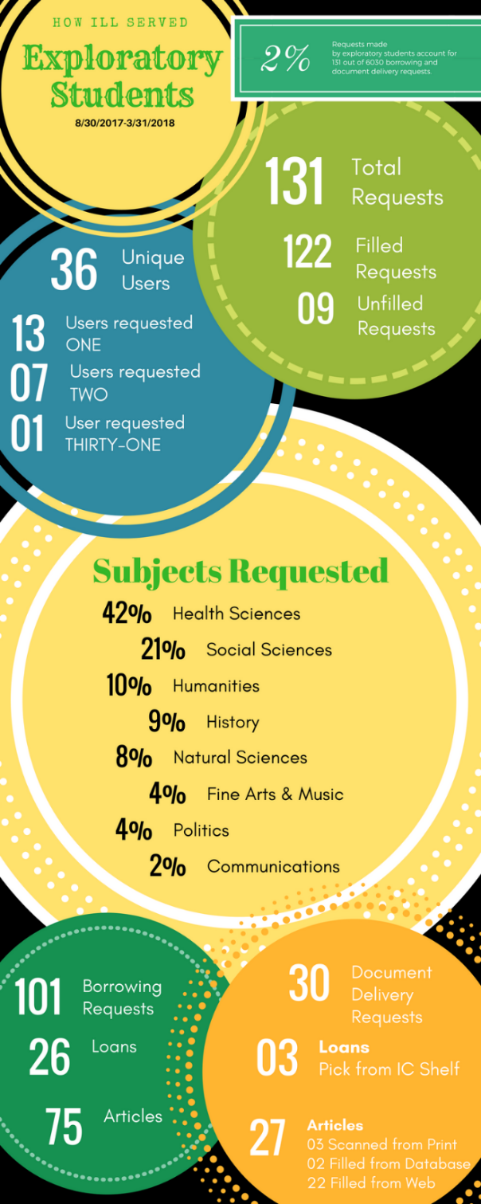
Chapter 3: What & When
As Needed/Special:
Track a new service/tool (e.g. database or ALMA)
Value of specific services (e.g. ROI for IDS)
For academics: impact on student success
Special report for reference Librarians at Ithaca College
Infographic generated using canva.com
Notes:
Then there are those times when you might be doing a shift at the reference desk and you overhear the librarians talking about how certain patron groups use the library. Sparks go off and you realize you can provide information on how a particular patron group utilizes the ILL/Document delivery service. So, these special requests can help us learn more about our patrons. It may also bolster the added value of software and technology to our services. For example, understanding the value of IDS. After becoming members, it was important to make sure that we were experiencing a good return on investment. We looked at how many requests we made from libraries that would have charged us had we not been in the project and costed those out with what our annual subscription is—the result was the project was helping us save a bunch of money just by reciprocity—not to mention the time saving in workflow and automation through logic.

Slide 9
Telling ILL's Story
Reports informing change/manage workflows
Request by day/time
Staff activity
Costing out ILL (e.g. cost per use)
Reasons for cancellations
Top lenders/borrowers (custom holdings/partnerships
Reports to help collaborate:
Cancelled—”Not on Shelf”
Most requested
Copyright
By user department
Who uses ILL e.g. staff v faculty/departments
Group Statistics in OCLC
Identify Common Themes
Quantity of Requests
Quality of Service (e.g. turnaround)
Housekeeping
Borrowing:
Picked up from shelf?
Collection development/serials
Lending:
Reason for No
Deflection Statistics
Document Delivery:
Cited-in data, etc.
Notes:
Borrowing: One common question borrowing specialists encounter is whether or not the items they are ordering are actually being used or not. Are patrons picking items up off of the shelves?
Lending:

Slide 10
Chapter 4: Where we gather
Other?
Qualitative Data:
Surveys
E-mail Comments/Kudos
Quantitative Data:
Rapid
Docline
Library System Data (Circulation, Acq. Other?)
Councils?
Delivery & Shipment Data
Web Reports:
Canned Reports developed by Atlas
Exportable to Excel
Customer Searches:
Saveable Queries
Customizeable (query & output)
Exportable to Excel
OCLC Statistics:
Canned reports developed by OCLC
Exportable to Excel

Slide 11
Lending:
Fill Rate Statistics
Who we lend to
Requests received by Day
Requests received by System ID
Requests filled by day
Requests filled and unfilled
Most loaned journals
Most loaned monographs
Most unfilled journals
Turnaround time
Request from lending web page
IFMCharge
Web Reports:
Borrowing:
Fill Rate Statistics
Most Requested Journals
Most Requested Loans
Registered Users by Department
Requests Received by Day
Requests Received by Hour
Requests Sent by Day
Requests Sent by Hour
Requests by Department
Requests by Department and User Status
Requests finished
Requests finished and cancelled
Turnaround time
Electronic Delivery Turnaround Time
Delivery Time Distribution
Who we borrow from
Journals Received
Worlcat Information
Document Delivery:
Fill Rate Statistics
Most filled journal requests
Received by Day
Requests filled by Day
Turnaround Time
Elec Del Turnaround Time
Requests by Department and User Status
Reasons for Cancellation
Requests finished and cancelled

Slide 12
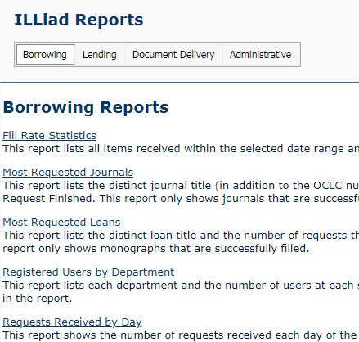
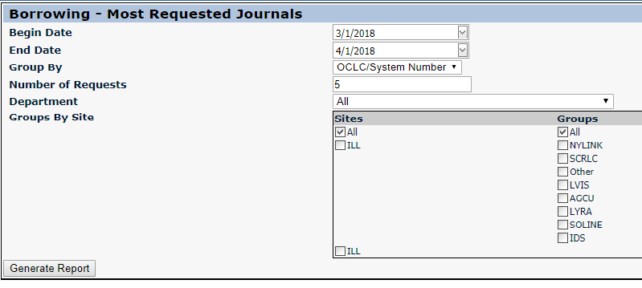
Web Reports:
What you see:
Administrative:
Copyright
Borrowing Invoices Received
Lending Library
Customers Cleared
Outstanding Requests
Requests by Username
Staff Activity by Username
Set specifications for the canned query:
How to Access:
Click on “System” tab
Use Illiad credentials

Slide 13
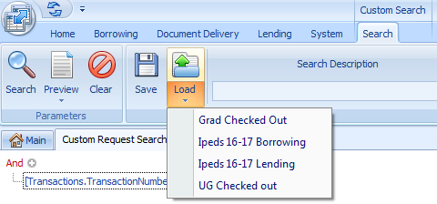
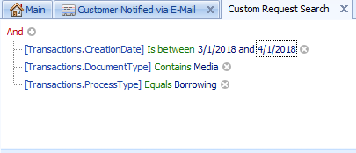
Custom Search:
Example: Books checked out to undergraduates
Custom Search on Home Tab
Example: Ipeds borrowing stats FY17
Load a Saved Search… or
Example: Borrowing media requests for March, 2018
Use the + to add criteria to the default settings in Custom Search

Slide 14
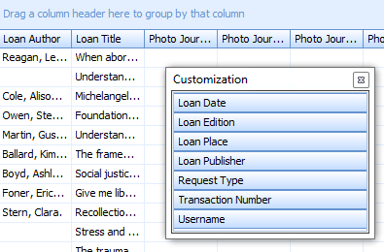
Custom Search: PRO TIPS
Column Chooser:
Remove columns from search results
Click & Drag unwanted columns into the column chooser
Save column preferences for future searches
Protect patron privacy
Export Files to Excel
Data can be manipulated before exporting
Move Columns around
Filter specific data/columns
**Any filtering/column changes will be exported**
Column Chooser in Action
Saved Searches:
Re-use common or reoccurring searches to avoid recreating the search each time

Slide 15
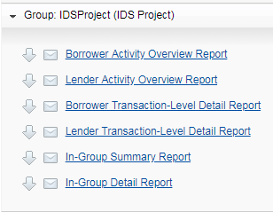
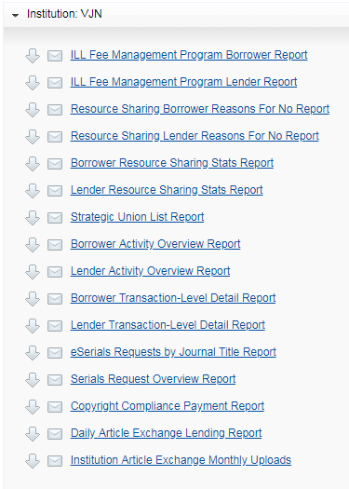
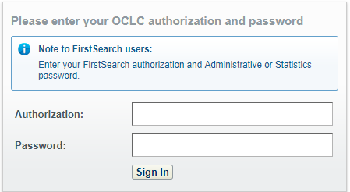
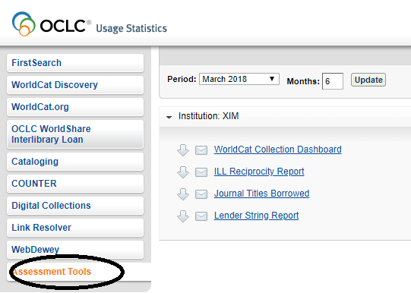
OCLC Usage Statistics
Consortium Level Reports:
Access:
Link to through Worldshare
http://www.stats.oclc.org/cusp/login
Institutional Level Reports:
Other Assessment Tools

Slide 16
Chapter 5: Practices
Best Practices
Gather statistics on a regular schedule
Compare apples to apples: have a consistent baseline
(e.g. save & reuse searches)
Document, document, document
Export files to Excel and save.
Write down how you collect various types of statistics if searches can’t be saved
(ex. OCLC Usage Statistics
Communicate results in ways that can be understood
Know your audience
Steer clear of too much jargon

Slide 17
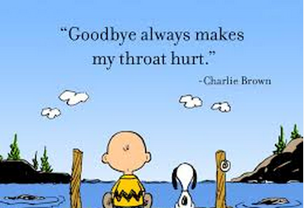
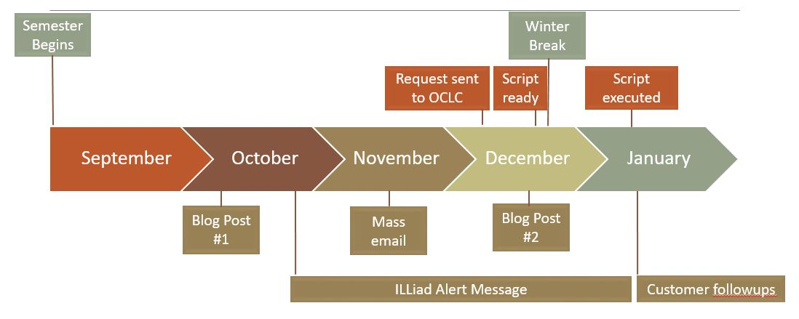
Protecting Privacy
Hosted?
Schedule delinking/deleting with OCLC
Self-Hosted?
(Very Carefully) use Database Manager to delink/delete
Communicate early and often with patrons about timelines
Don’t use patron info if possible
If using patron info, purge any saved patron info as possible once finished.
Delinking vs. Deleting
Delink
Deleting TNs
Deleting Usernames
Break the relationship between users table and transactions table
Delete completed transactions that are older than a given date
Usernames that no longer have transactions can also be deleted

Slide 18
Chapter 6: Turning the Pages
What challenges do you experience in data gathering/storytelling? ​
​
What tools do you use to tell your ILL stories?​
What stories do you tell?
Has your data gathering led to change?
What changes would you like to see that data might support?

Slide 19
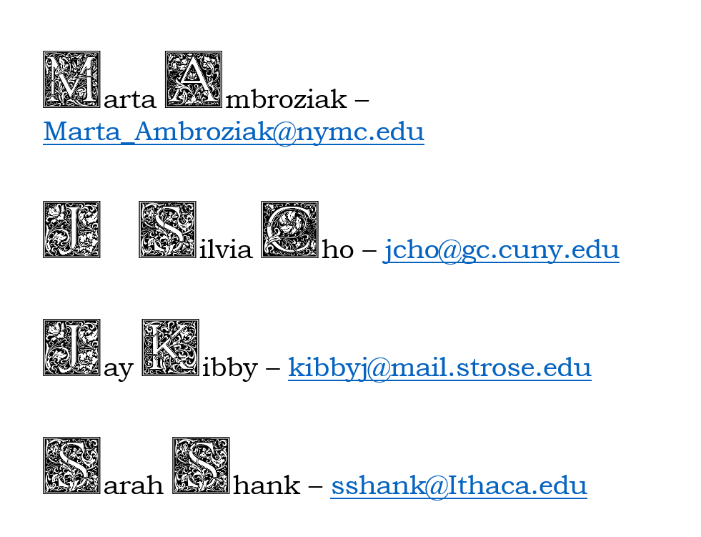
Notes:
I have the fancy letters here, I'll have to save each as picture and import.

